Slide 1
Module: 6 Hypothesis Testing II
Small Sample Tests – Student’s t-Test – F-Test – Chi-Square Test –Goodness of Fit – Independence of Attributes – Design of Experiments– Analysis of Variance – One and Two Way Classifications - CRD-RBD-LSD.

Slide 2
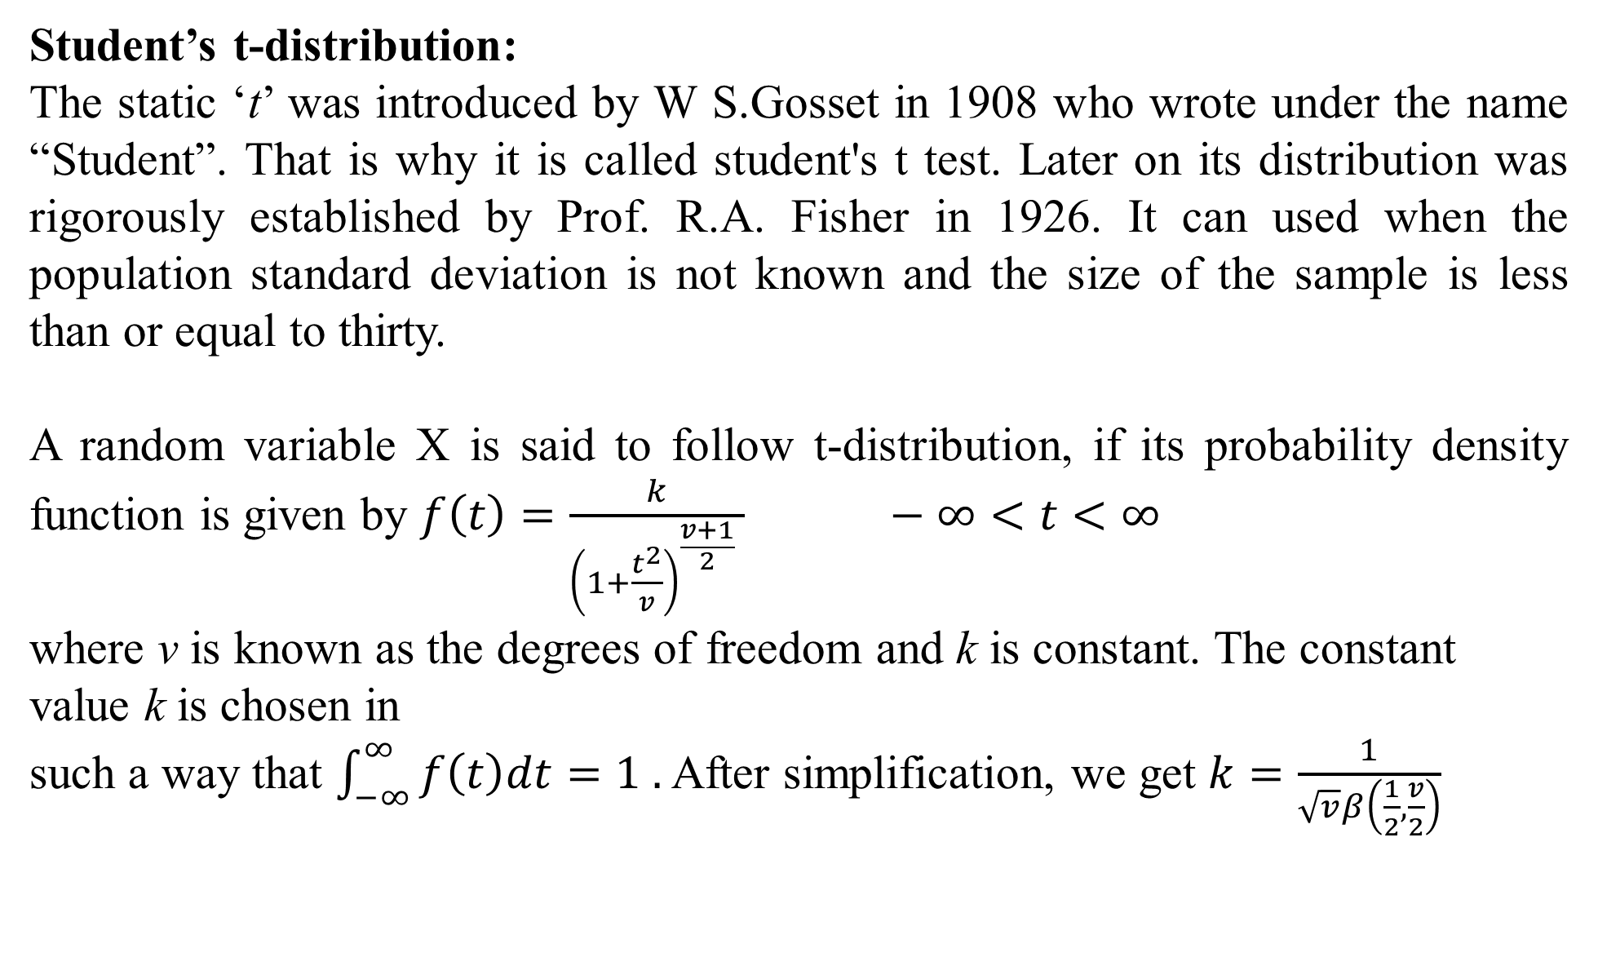
Student’s t-distribution:
The static ‘t’ was introduced by W S.Gosset in 1908 who wrote under the name “Student”. That is why it is called student's t test. Later on its distribution was rigorously established by Prof. R.A. Fisher in 1926. It can used when the population standard deviation is not known and the size of the sample is less than or equal to thirty.
A random variable X is said to follow t-distribution, if its probability density function is given by $f\left(t\right)=\frac{k}{{\left(1+\frac{t^{2}}{v}\right)}^{\frac{v+1}{2}} } −∞<t<∞$
where v is known as the degrees of freedom and k is constant. The constant value k is chosen in
such a way that $\int_{−∞}^{∞}{f\left(t\right)dt=1 .}$ After simplification, we get $k=\frac{1}{\sqrt{v}β\left(\frac{1}{2},\frac{v}{2}\right)}$

Slide 3
Assumption of t-distribution:
The population from which the sample is drawn is normal.
The sample is random and size n ≤ 30.
The population S.D. σ is not known.
Properties of t-distribution:
The probability curve of t-distribution is symmetrical.
The tails of the curve are asymptotic to x-axis.
When n→ ∞, t- distribution tends to normal distribution.
The form of the t- distribution aries with the degrees of freedom.
Application of t- distribution: The t- distribution is used
To test significance of the mean of sample.
To test the difference between two means or to compare two samples

Slide 4
Level of significance and $α$ critical region:

Slide 5
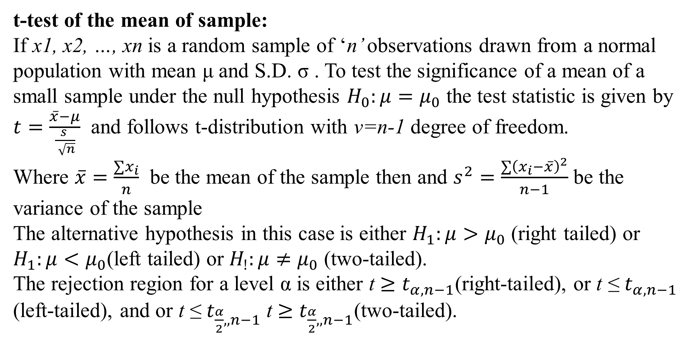
t-test of the mean of sample:
If x1, x2, …, xn is a random sample of ‘n’ observations drawn from a normal population with mean μ and S.D. σ . To test the significance of a mean of a small sample under the null hypothesis $H_{0}:μ=μ_{0}$ the test statistic is given by
$t=\frac{\overline{x}−μ}{\frac{s }{ \sqrt{n}}}$ and follows t-distribution with v=n-1 degree of freedom.
Where $\overline{x}=\frac{∑x_{i}}{n}$ be the mean of the sample then and $s^{2}=\frac{∑{\left(x_{i}−\overline{x}\right)}^{2}}{n−1}$ be the variance of the sample
The alternative hypothesis in this case is either $H_{1}:μ>μ_{0}$ (right tailed) or $H_{1}:μ<μ_{0}$(left tailed) or $H_{!}:μ≠μ_{0}$ (two-tailed).
The rejection region for a level α is either t $≥t_{α, n−1}$(right-tailed), or t ≤ $t_{α, n−1}$ (left-tailed), and or t ≤ $t_{\frac{α}{2},, n−1}$ t $≥$ $t_{\frac{α}{2},, n−1}$(two-tailed).

Slide 6
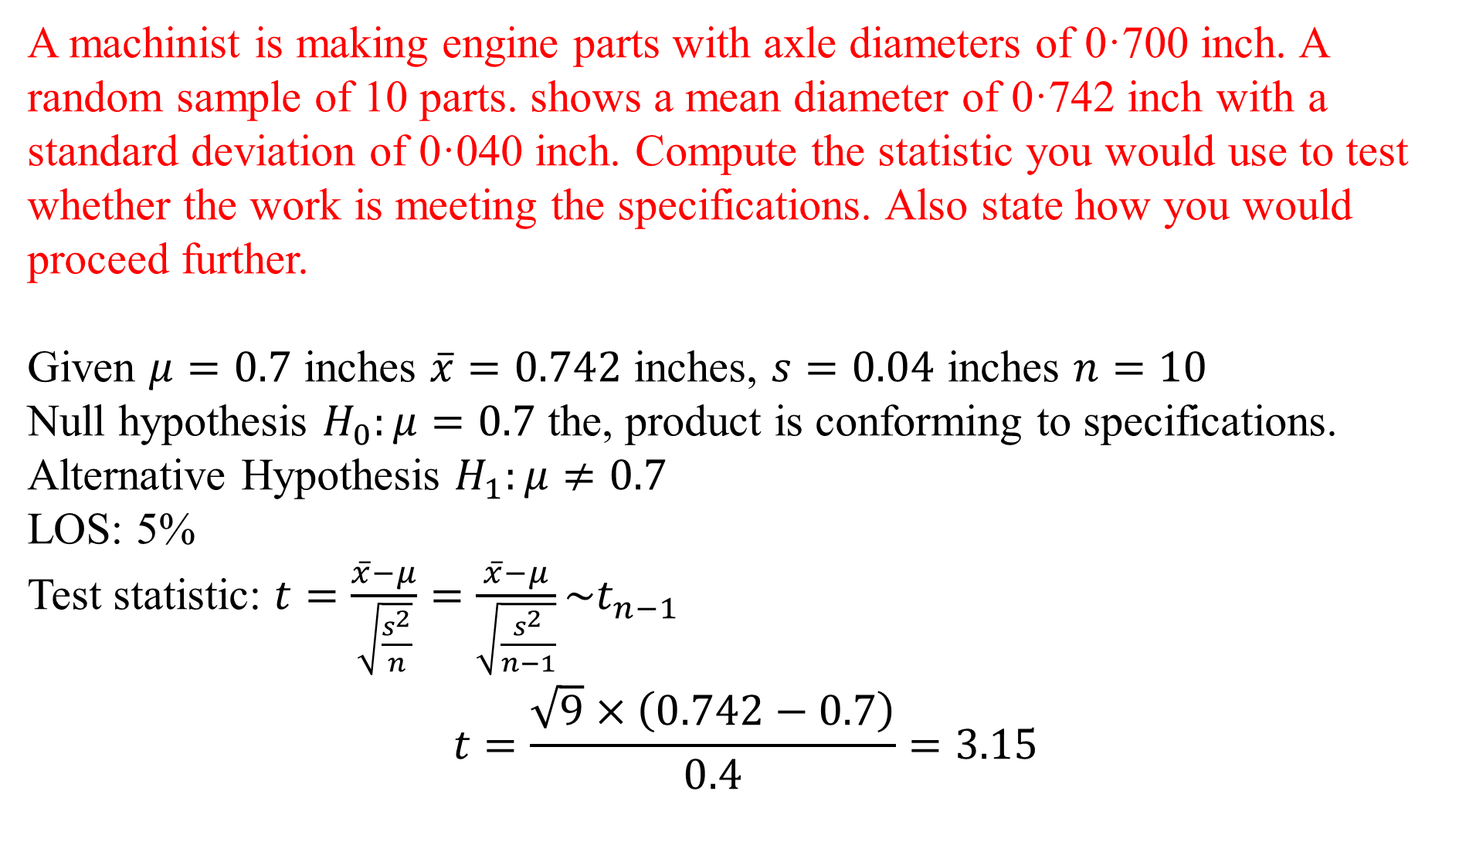
A machinist is making engine parts with axle diameters of 0·700 inch. A random sample of 10 parts. shows a mean diameter of 0·742 inch with a standard deviation of 0·040 inch. Compute the statistic you would use to test whether the work is meeting the specifications. Also state how you would proceed further.
Given $μ=0.7$ inches $\overline{x}=0.742$ inches, $s=0.04$ inches $n=10$
Null hypothesis $H_{0}:μ=0.7$ the, product is conforming to specifications.
Alternative Hypothesis $H_{1}:μ≠0.7$
LOS: 5%
Test statistic: $t=\frac{\overline{x}−μ}{\sqrt{\frac{s^{2}}{n}}}=\frac{\overline{x}−μ}{\sqrt{\frac{s^{2}}{n−1}}}\sim t_{n−1}$
$$t=\frac{\sqrt{9}×\left(0.742−0.7\right)}{0.4}=3.15$$

Slide 7
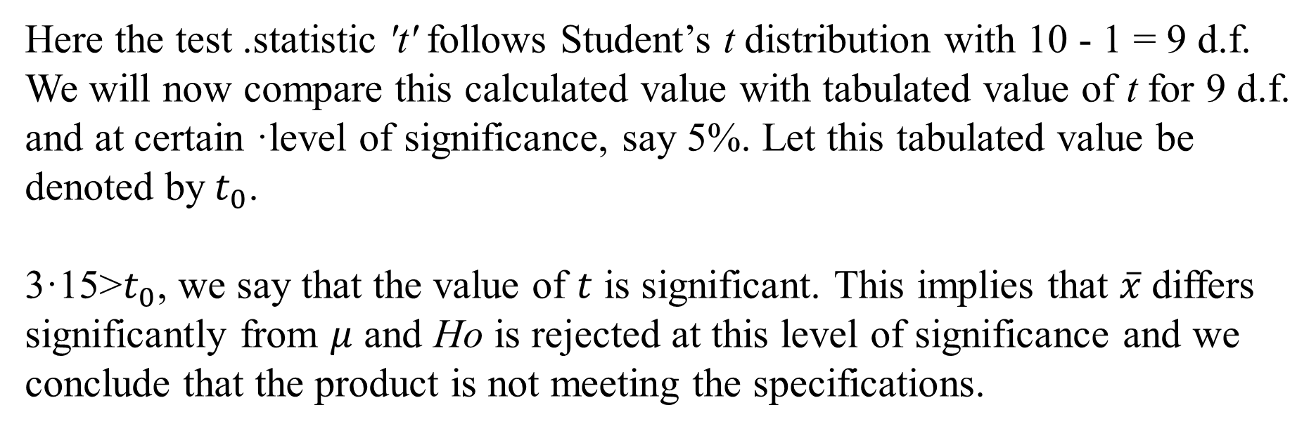
Here the test .statistic 't' follows Student’s t distribution with 10 - 1 = 9 d.f. We will now compare this calculated value with tabulated value of t for 9 d.f. and at certain ·level of significance, say 5%. Let this tabulated value be denoted by${ t}_{0}$.
3·15>$t_{0}$, we say that the value of $t$ is significant. This implies that $\overline{x}$differs significantly from $μ$ and Ho is rejected at this level of significance and we conclude that the product is not meeting the specifications.

Slide 8
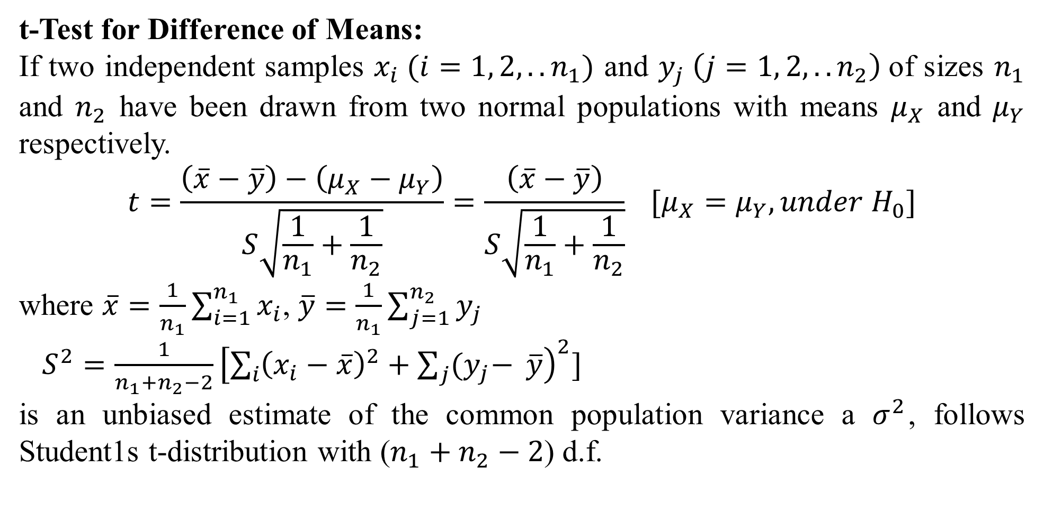
t-Test for Difference of Means:
If two independent samples $x_{i} (i=1, 2, ..n_{1})$ and $y_{j} \left(j=1, 2, ..n_{2}\right)$of sizes $n_{1}$ and $n_{2}$ have been drawn from two normal populations with means $μ_{X}$ and $μ_{Y}$ respectively.
$$t=\frac{\left(\overline{x}−\overline{y}\right)−\left(μ_{X}−μ_{Y}\right)}{S\sqrt{\frac{1}{n_{1}}+\frac{1}{n_{2}}}}=\frac{\left(\overline{x}−\overline{y}\right)}{S\sqrt{\frac{1}{n_{1}}+\frac{1}{n_{2}}}} [μ_{X}=μ_{Y}, under H_{0}]$$
where $\overline{x}=\frac{1}{n_{1}}\sum_{i=1}^{n_{1}}{x_{i}}$, $\overline{y}=\frac{1}{n_{1}}\sum_{j=1}^{n_{2}}{y_{j}}$
$S^{2}=\frac{1}{n_{1}+n_{2}−2}{\left[\sum_{i}{{\left(x_{i}−\overline{x}\right)}^{2}}+\sum_{j}{{(y}_{j}−} \overline{y}\right)}^{2}]$
is an unbiased estimate of the common population variance a $σ^{2}$, follows Student1s t-distribution with ($n_{1}+n_{2}−2$) d.f.

Slide 9
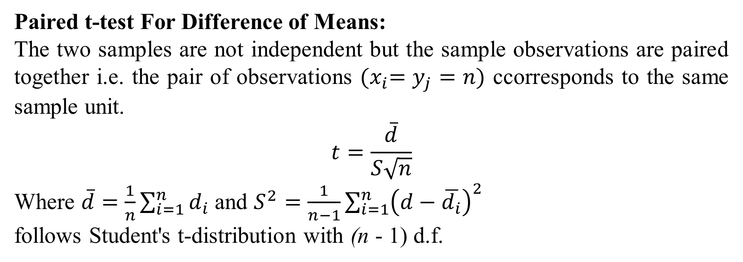
Paired t-test For Difference of Means:
The two samples are not independent but the sample observations are paired together i.e. the pair of observations ${(x}_{i}=y_{j}=n)$ ccorresponds to the same sample unit.
$$t=\frac{\overline{d}}{S\sqrt{n}}$$
Where $\overline{d}=\frac{1}{n}\sum_{i=1}^{n}{d_{i}}$ and $S^{2}=\frac{1}{n−1}\sum_{i=1}^{n}{{\left(d−\overline{d_{i}}\right)}^{2}}$
follows Student's t-distribution with (n - 1) d.f.

Slide 10
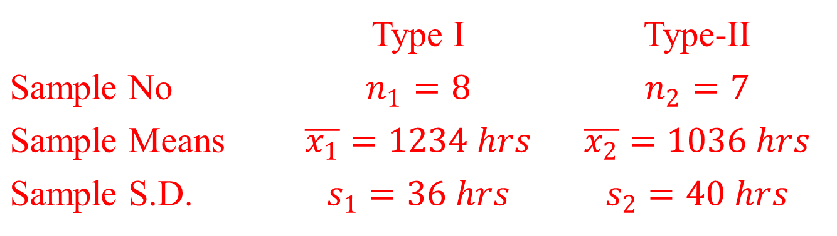
Samples of two types of electric light bulbs were tested Jor length of life, and the following data were obtained:
Is the difference in the means sufficient to warrant that type I is superior to
type II regarding length of life?
 | Type I | Type-II
Sample No | $$n_{1}=8$$ | $$n_{2}=7$$
Sample Means | $$\overline{x_{1}}=1234 hrs$$ | $$\overline{x_{2}}=1036 hrs$$
Sample S.D. | $$s_{1}=36 hrs$$ | $$s_{2}=40 hrs$$

Slide 11
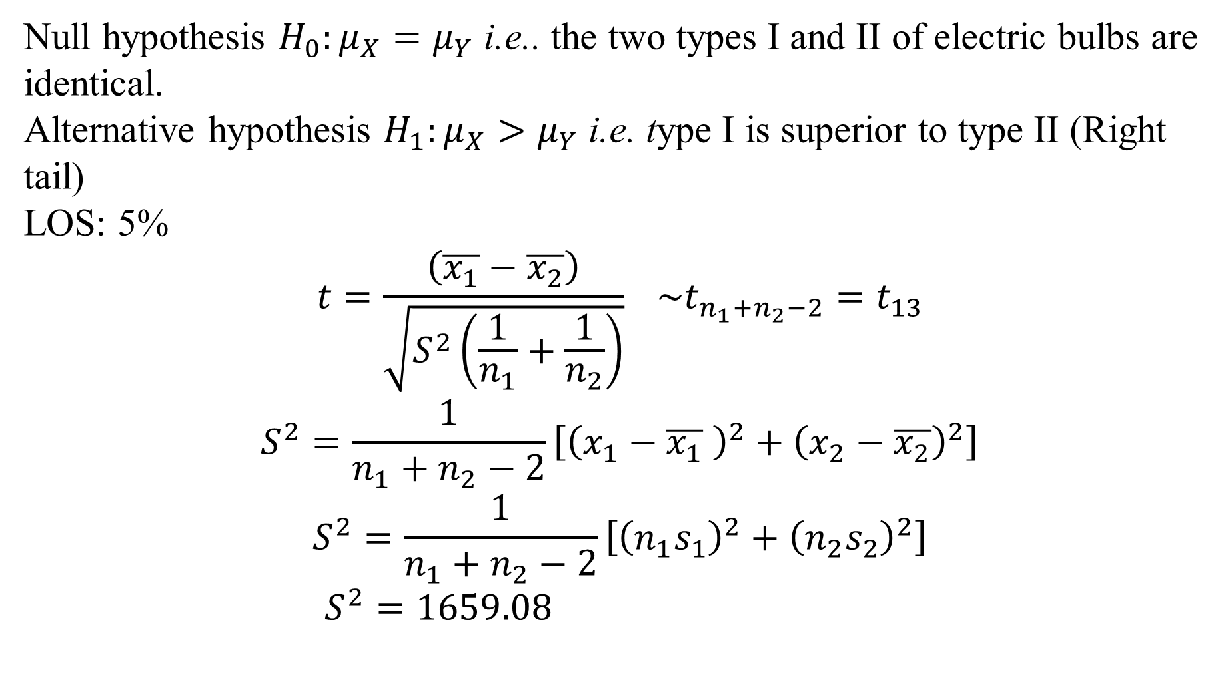
Null hypothesis $H_{0}:μ_{X}=μ_{Y}$ i.e.. the two types I and II of electric bulbs are identical.
Alternative hypothesis $H_{1}:μ_{X}>μ_{Y}$ i.e. type I is superior to type II (Right tail)
LOS: 5%
$$t=\frac{\left(\overline{x_{1}}−\overline{x_{2}}\right)}{\sqrt{S^{2}\left(\frac{1}{n_{1}}+\frac{1}{n_{2}}\right)}} \sim t_{n_{1}+n_{2}−2}=t_{13}$$
$$S^{2}=\frac{1}{n_{1}+n_{2}−2}\left[{\left(x_{1}−\overline{x_{1}} \right)}^{2}+{\left(x_{2}−\overline{x_{2}}\right)}^{2}\right]$$
$$S^{2}=\frac{1}{n_{1}+n_{2}−2}\left[{\left(n_{1}s_{1}\right)}^{2}+{\left(n_{2}s_{2}\right)}^{2}\right]$$
$S^{2}=1659.08$

Slide 12
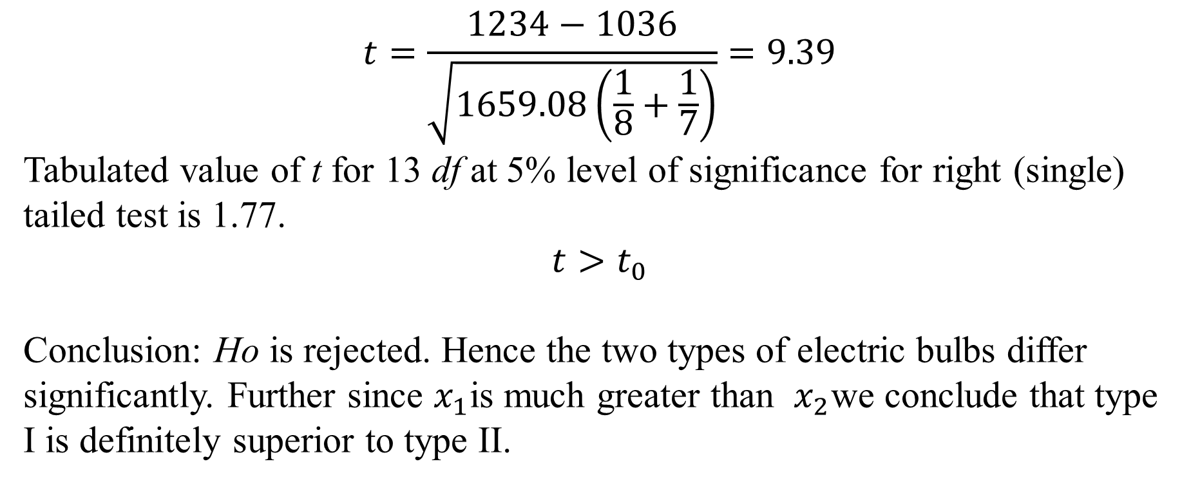
$$t=\frac{1234−1036}{\sqrt{1659.08\left(\frac{1}{8}+\frac{1}{7}\right)}}=9.39$$
Tabulated value of t for 13 df at 5% level of significance for right (single) tailed test is 1.77.
$$t>t_{0}$$
Conclusion: Ho is rejected. Hence the two types of electric bulbs differ significantly. Further since $x_{1}$is much greater than $x_{2}$we conclude that type I is definitely superior to type II.

Slide 13
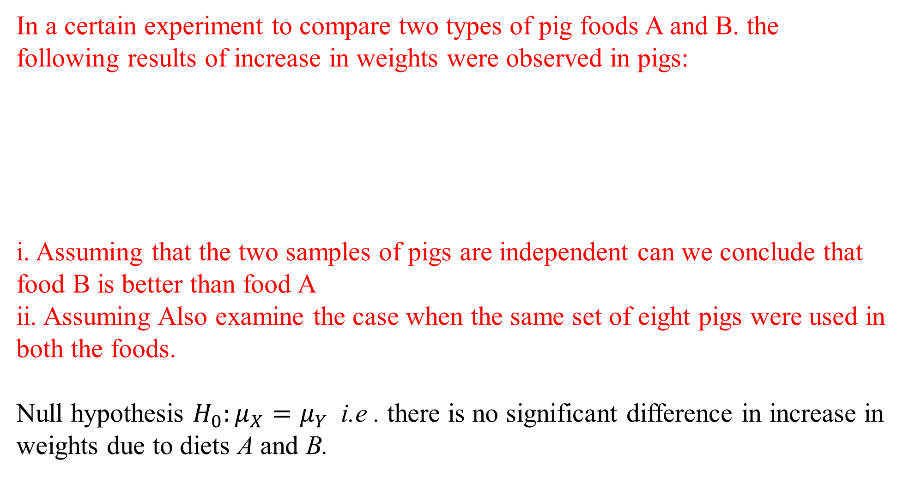
In a certain experiment to compare two types of pig foods A and B. the following results of increase in weights were observed in pigs:
i. Assuming that the two samples of pigs are independent can we conclude that food B is better than food A
ii. Assuming Also examine the case when the same set of eight pigs were used in both the foods.
Null hypothesis $H_{0}:μ_{X}=μ_{Y}$ i.e . there is no significant difference in increase in weights due to diets A and B.
Pig number |  | 1 | 2 | 3 | 4 | 5 | 6 | 7 | 8 | Total
Increase in weight in lb | Food A | 49 | 53 | 51 | 52 | 47 | 50 | 52 | 53 | 407
 | Food B | 52 | 55 | 52 | 53 | 50 | 54 | 54 | 53 | 423

Slide 14
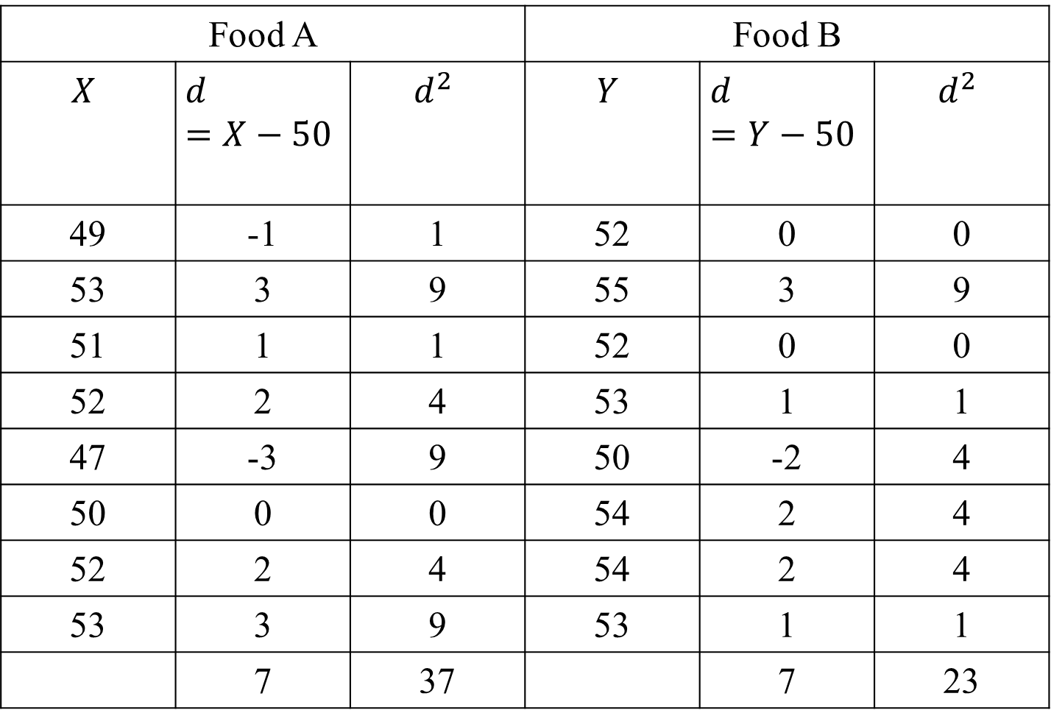
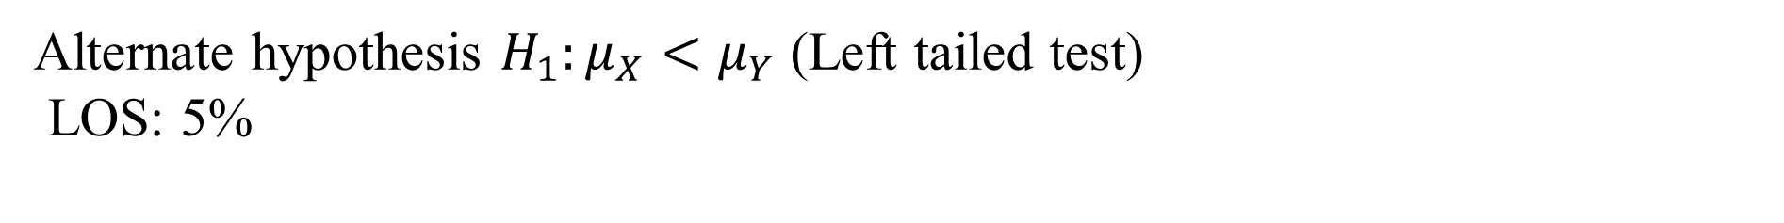
Alternate hypothesis $H_{1}:μ_{X}<μ_{Y}$ (Left tailed test)
LOS: 5%
Food A |  |  | Food B
$$X$$ | $$d=X−50$$ | $$d^{2}$$ | $$Y$$ | $$d=Y−50$$ | $$d^{2}$$
49 | -1 | 1 | 52 | 0 | 0
53 | 3 | 9 | 55 | 3 | 9
51 | 1 | 1 | 52 | 0 | 0
52 | 2 | 4 | 53 | 1 | 1
47 | -3 | 9 | 50 | -2 | 4
50 | 0 | 0 | 54 | 2 | 4
52 | 2 | 4 | 54 | 2 | 4
53 | 3 | 9 | 53 | 1 | 1
 | 7 | 37 |  | 7 | 23

Slide 15
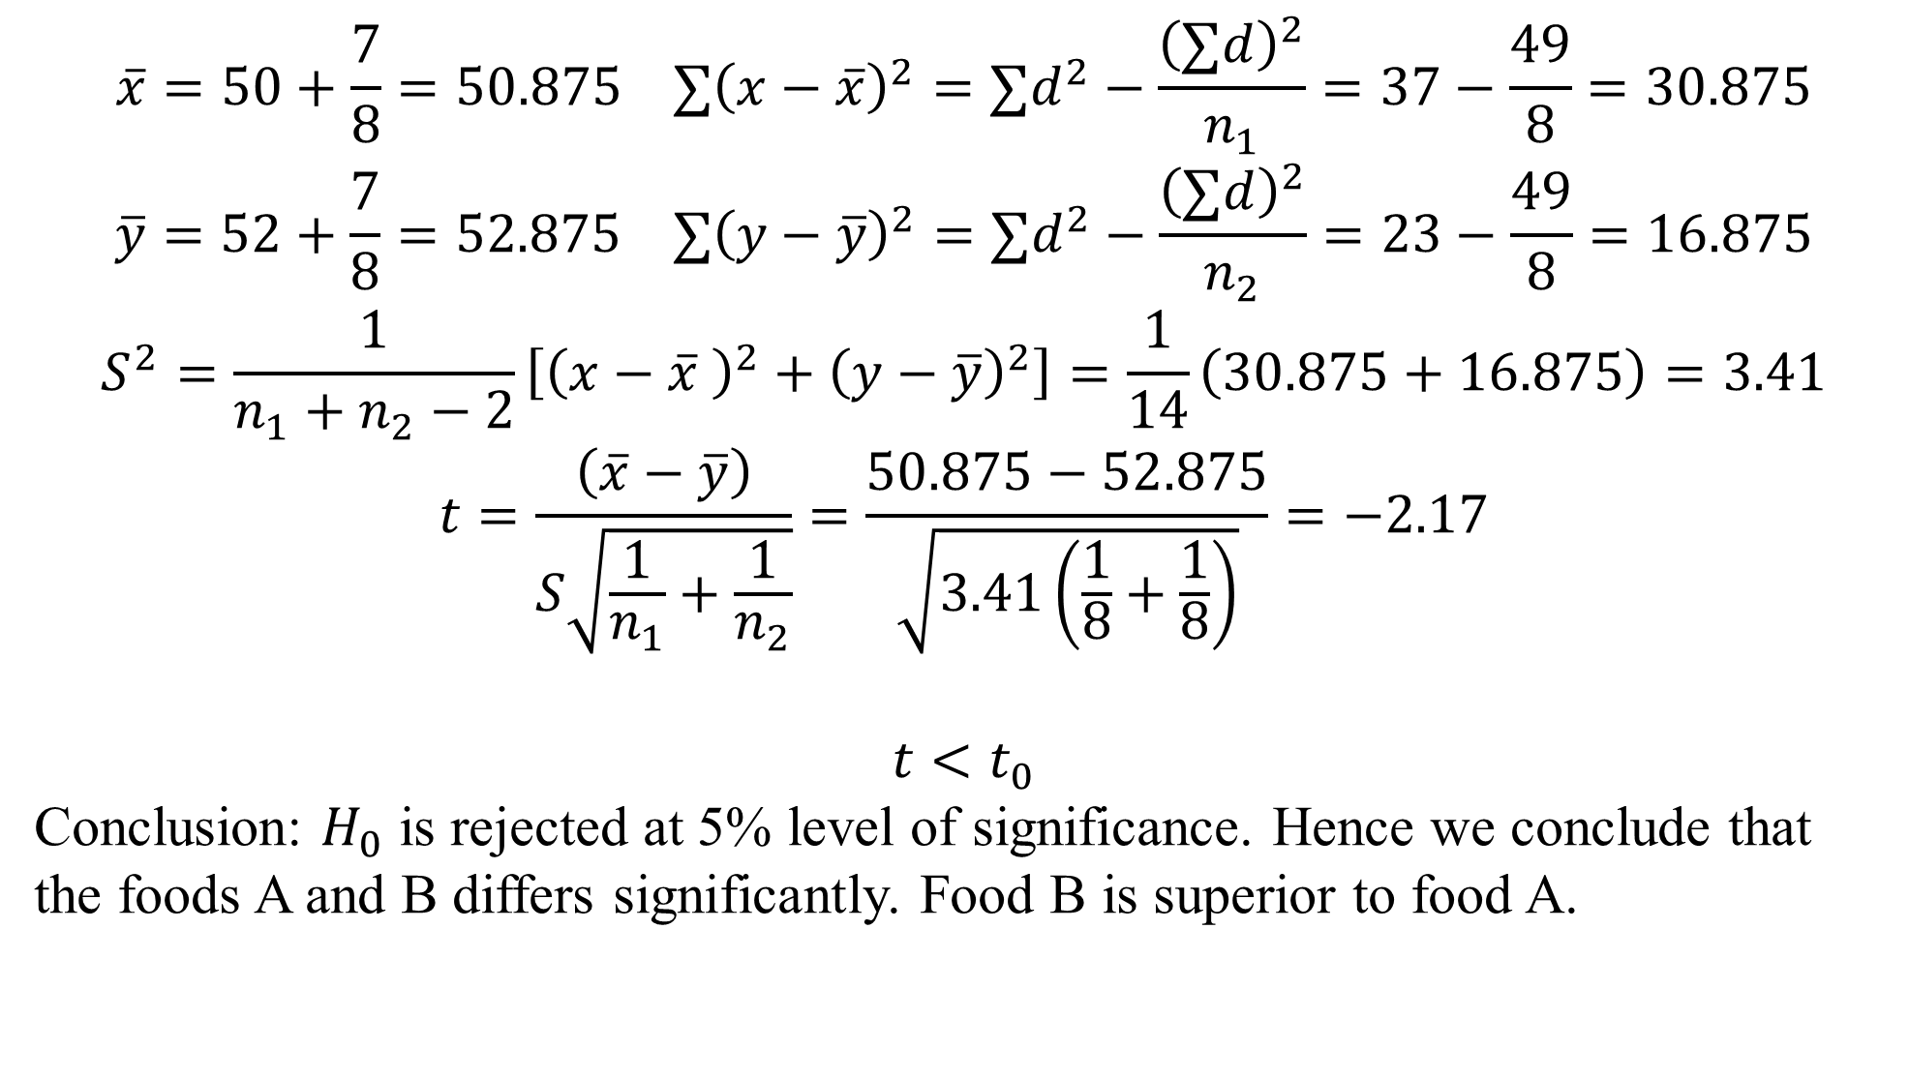
$$\overline{x}=50+\frac{7}{8}=50.875 ∑{\left(x−\overline{x}\right)}^{2}=∑d^{2}−\frac{{\left(∑d\right)}^{2}}{n_{1}}=37−\frac{49}{8}=30.875$$
$$\overline{y}=52+\frac{7}{8}=52.875 ∑{\left(y−\overline{y}\right)}^{2}=∑d^{2}−\frac{{\left(∑d\right)}^{2}}{n_{2}}=23−\frac{49}{8}=16.875$$
$$S^{2}=\frac{1}{n_{1}+n_{2}−2}\left[{\left(x−\overline{x} \right)}^{2}+{\left(y−\overline{y}\right)}^{2}\right]=\frac{1}{14}\left(30.875+16.875\right)=3.41$$
$$t=\frac{\left(\overline{x}−\overline{y}\right)}{S\sqrt{\frac{1}{n_{1}}+\frac{1}{n_{2}}}}=\frac{50.875−52.875}{\sqrt{3.41\left(\frac{1}{8}+\frac{1}{8}\right)}}=−2.17$$
$$t<t_{0}$$
Conclusion: $H_{0}$ is rejected at 5% level of significance. Hence we conclude that the foods A and B differs significantly. Food B is superior to food A.

Slide 16
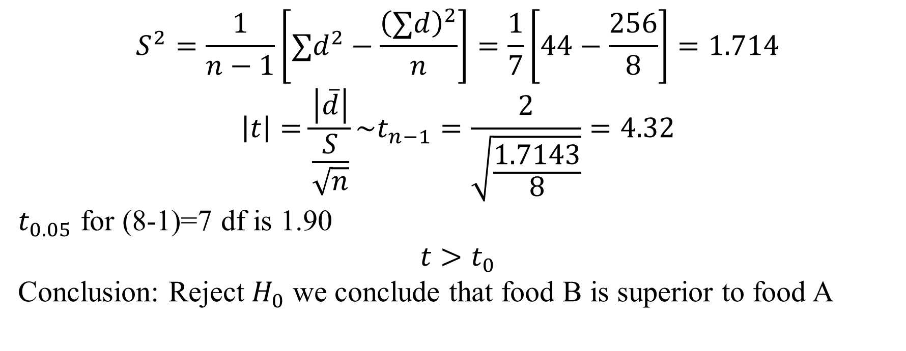
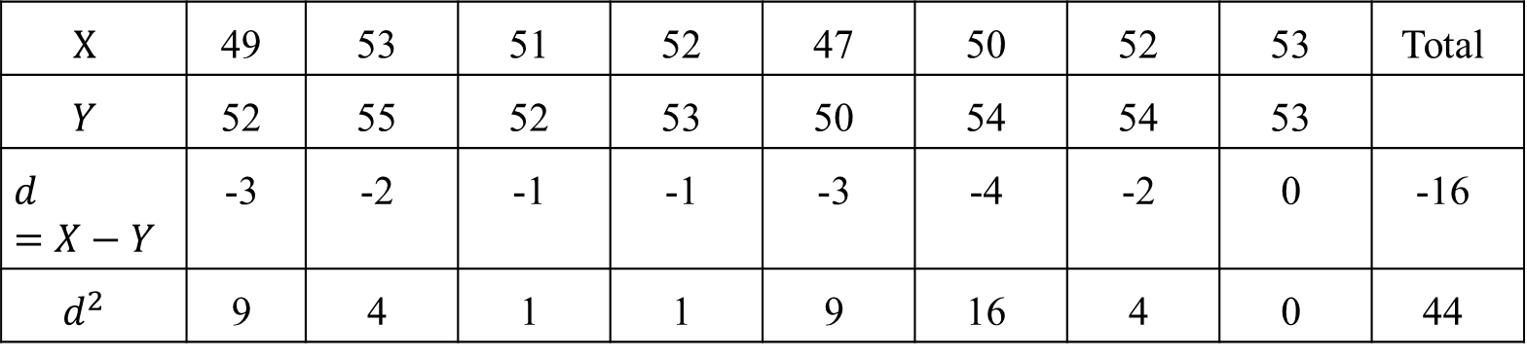
$$X$$ | 49 | 53 | 51 | 52 | 47 | 50 | 52 | 53 | Total
$$Y$$ | 52 | 55 | 52 | 53 | 50 | 54 | 54 | 53
$$d=X−Y$$ | -3 | -2 | -1 | -1 | -3 | -4 | -2 | 0 | -16
$$d^{2}$$ | 9 | 4 | 1 | 1 | 9 | 16 | 4 | 0 | 44
ii)
$$S^{2}=\frac{1}{n−1}\left[∑d^{2}−\frac{{\left(∑d\right)}^{2}}{n}\right]=\frac{1}{7}\left[44−\frac{256}{8}\right]=1.714$$
$$\left|t\right|=\frac{\left|\overline{d}\right|}{\frac{S}{\sqrt{n}}}\sim t_{n−1}=\frac{2}{\sqrt{\frac{1.7143}{8}}}=4.32$$
$t_{0.05}$ for (8-1)=7 df is 1.90
$$t>t_{0}$$
Conclusion: Reject $H_{0}$ we conclude that food B is superior to food A

Slide 17
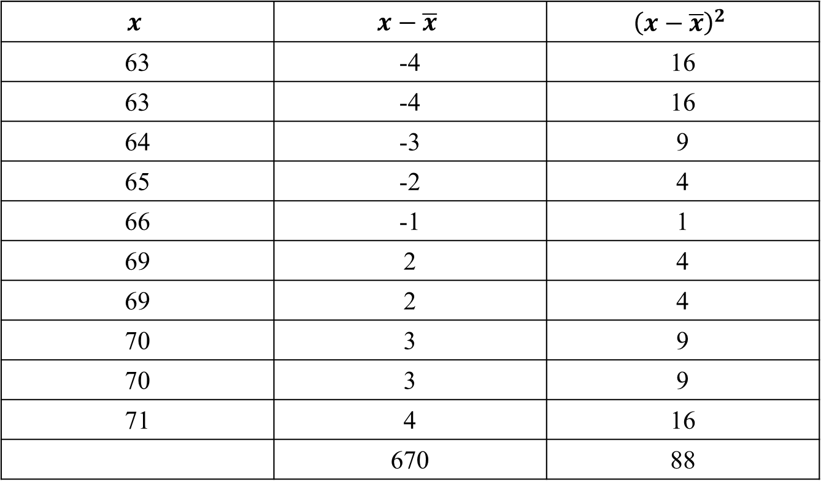
Ten individuals are chosen at random from a population and their heights are found to be in inches 63,63,64,65,66,69,69,70,70,71 discuss the suggestion that the mean height in the universe is 65 inches given that for 9 degrees of freedom the value of Student's t and 5 percent level of significance is 2.262.
$$x$$ | $$x−\overline{x}$$ | $${\left(x−\overline{x}\right)}^{2}$$
63 | -4 | 16
63 | -4 | 16
64 | -3 | 9
65 | -2 | 4
66 | -1 | 1
69 | 2 | 4
69 | 2 | 4
70 | 3 | 9
70 | 3 | 9
71 | 4 | 16
 | 670 | 88

Slide 18
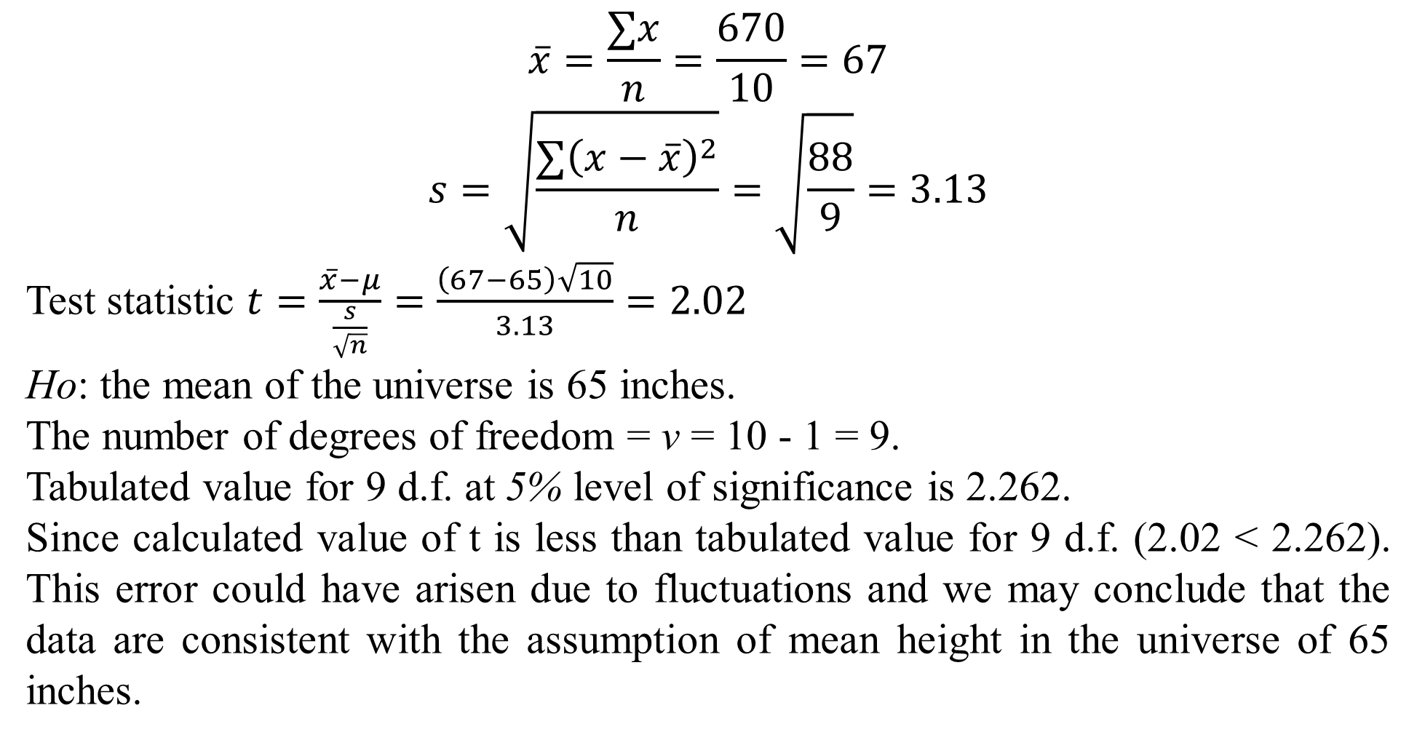
$$\overline{x}=\frac{∑x}{n}=\frac{670}{10}=67$$
$$s=\sqrt{\frac{∑{\left(x−\overline{x}\right)}^{2}}{n}}=\sqrt{\frac{88}{9}}=3.13$$
Test statistic $t=\frac{\overline{x}−μ}{\frac{s}{\sqrt{n}}}=\frac{\left(67−65\right)\sqrt{10}}{3.13}=2.02$
Ho: the mean of the universe is 65 inches.
The number of degrees of freedom = v = 10 - 1 = 9.
Tabulated value for 9 d.f. at 5% level of significance is 2.262.
Since calculated value of t is less than tabulated value for 9 d.f. (2.02 < 2.262). This error could have arisen due to fluctuations and we may conclude that the data are consistent with the assumption of mean height in the universe of 65 inches.

Slide 19
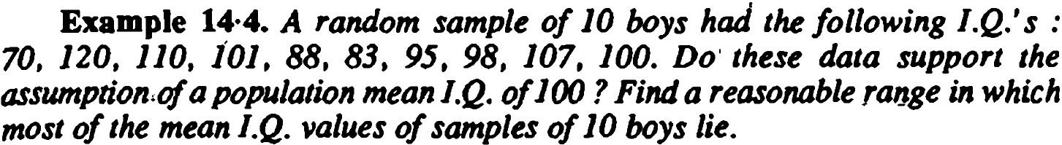
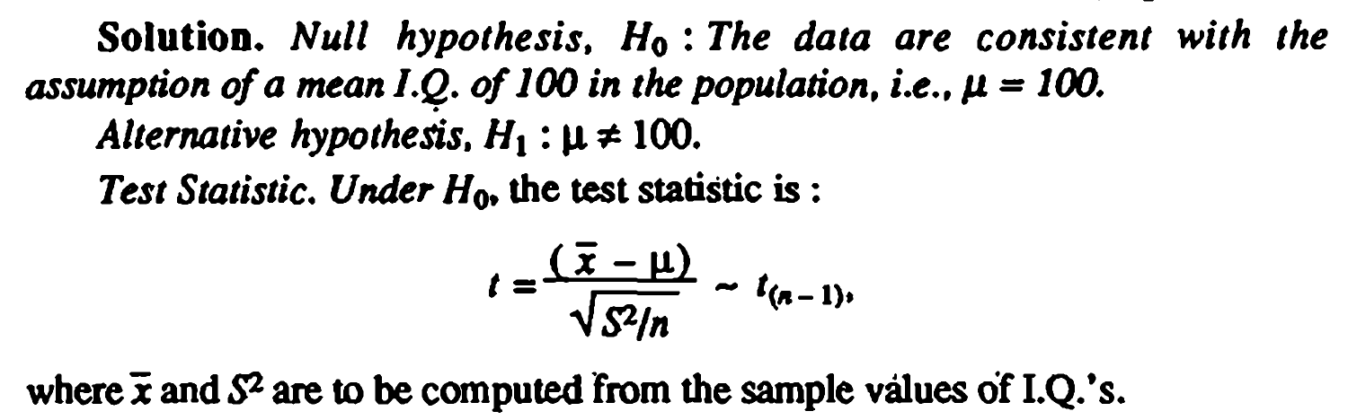


Slide 20
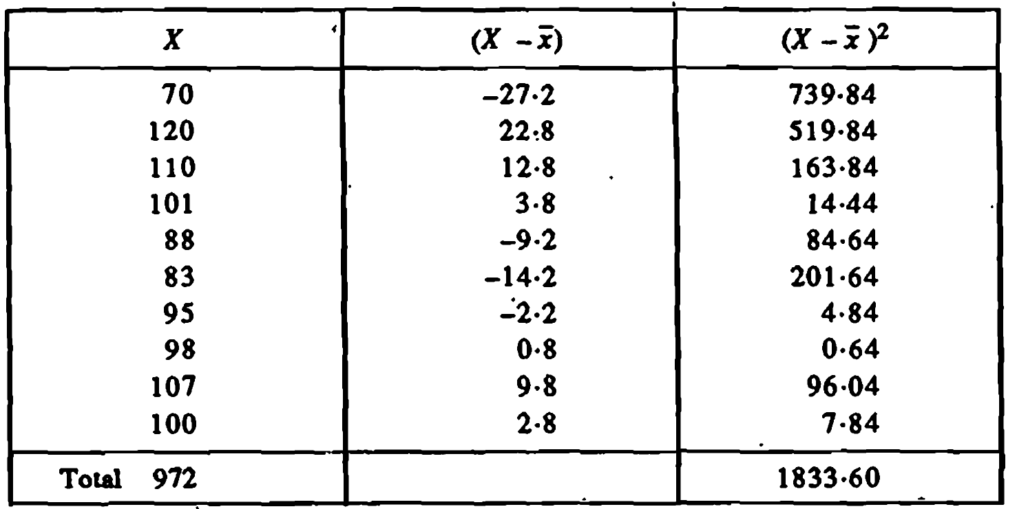

Slide 21
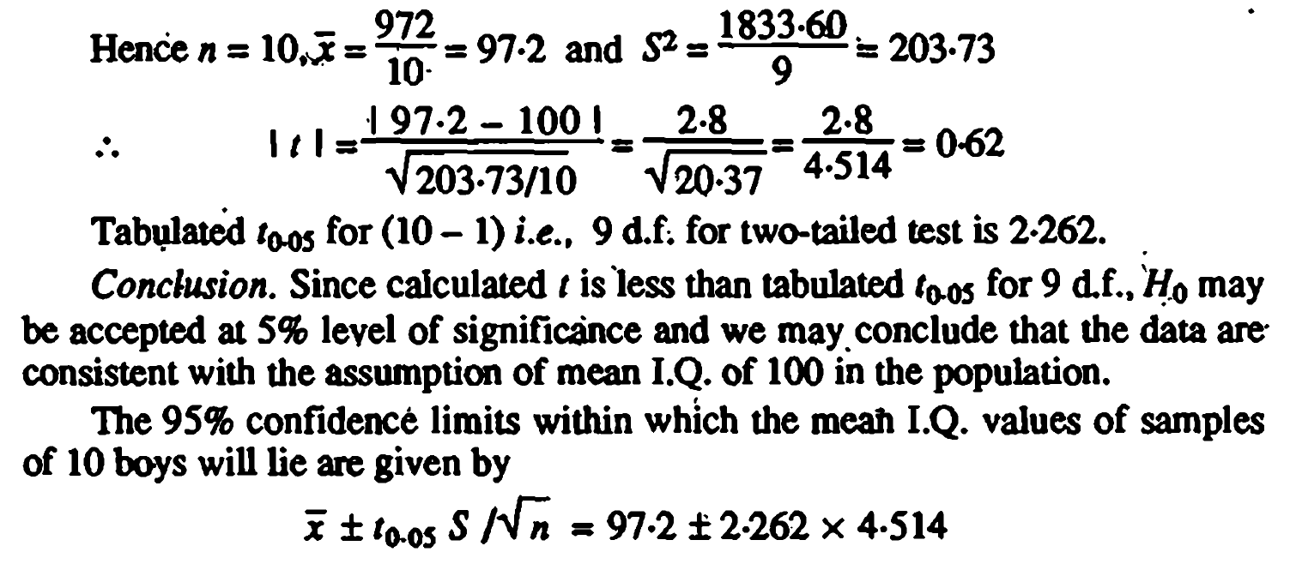

Slide 22
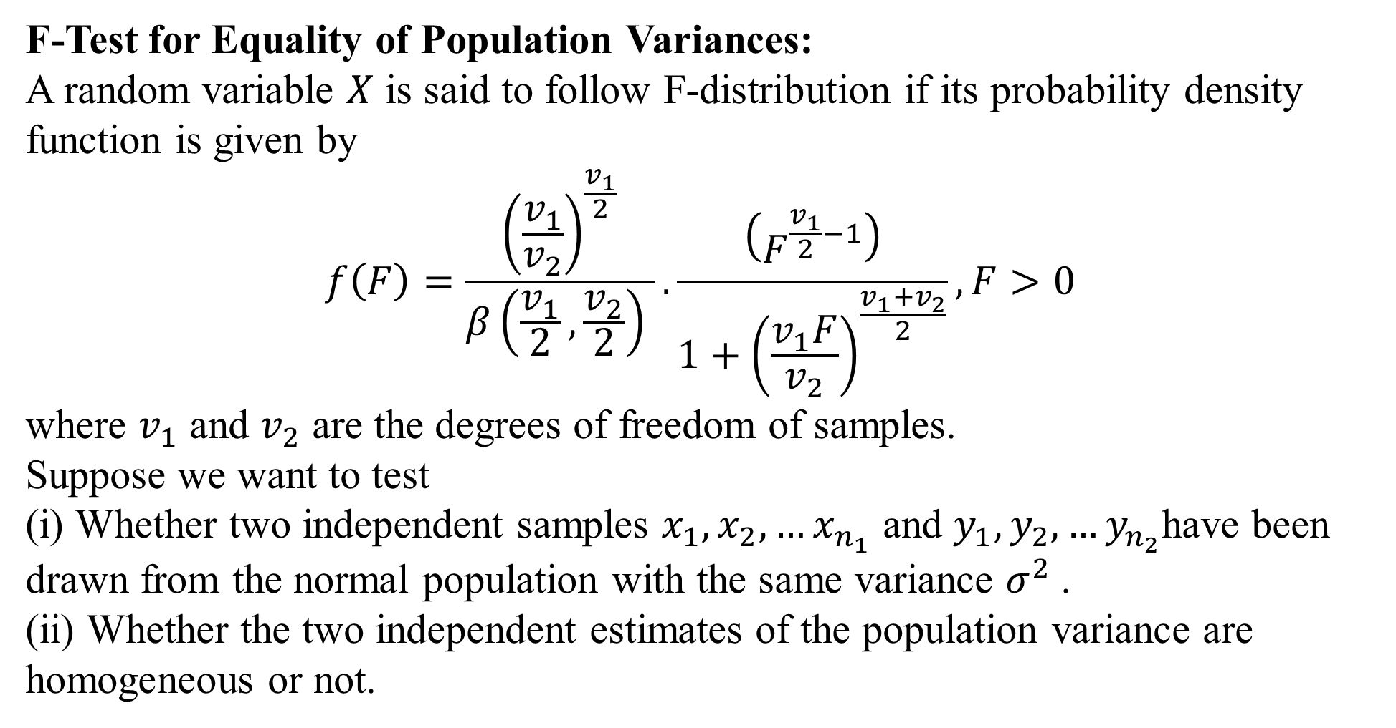
F-Test for Equality of Population Variances:
A random variable $X$ is said to follow F-distribution if its probability density function is given by
$$f\left(F\right)=\frac{{\left(\frac{v_{1}}{v_{2}}\right)}^{\frac{v_{1}}{2}}}{β\left(\frac{v_{1}}{2},\frac{v_{2}}{2}\right) }.\frac{\left(F^{\frac{v_{1}}{2}−1}\right)}{1+{\left(\frac{v_{1}F}{v_{2}}\right)}^{\frac{v_{1}+v_{2}}{2}}}, F>0$$
where $v_{1}$ and $v_{2}$ are the degrees of freedom of samples.
Suppose we want to test
(i) Whether two independent samples $x_{1},x_{2}, …x_{n_{1}}$ and $y_{1}, y_{2}, …y_{n_{2}}$have been drawn from the normal population with the same variance $σ^{2}$.
(ii) Whether the two independent estimates of the population variance are homogeneous or not.

Slide 23
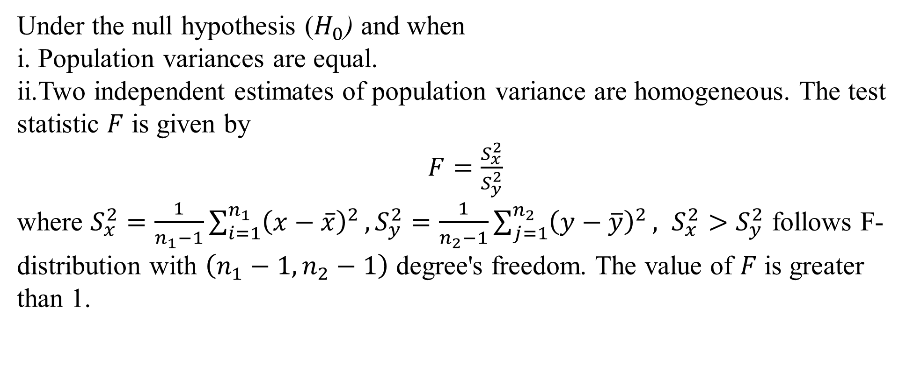
Under the null hypothesis ($H_{0}$) and when
i. Population variances are equal.
ii.Two independent estimates of population variance are homogeneous. The test statistic $F$ is given by
$F=\frac{S_{x}^{2}}{S_{y}^{2}}$
where $S_{x}^{2}=\frac{1}{n_{1}−1}\sum_{i=1}^{n_{1}}{{\left(x−\overline{x}\right)}^{2}},S_{y}^{2}=\frac{1}{n_{2}−1}\sum_{j=1}^{n_{2}}{{\left(y−\overline{y}\right)}^{2}}, S_{x}^{2}>S_{y}^{2}$ follows F-distribution with $\left(n_{1}−1, n_{2}−1\right)$ degree's freedom. The value of $F$ is greater than 1.

Slide 24
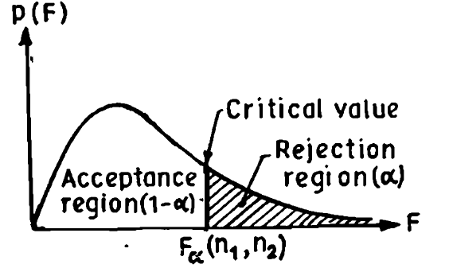
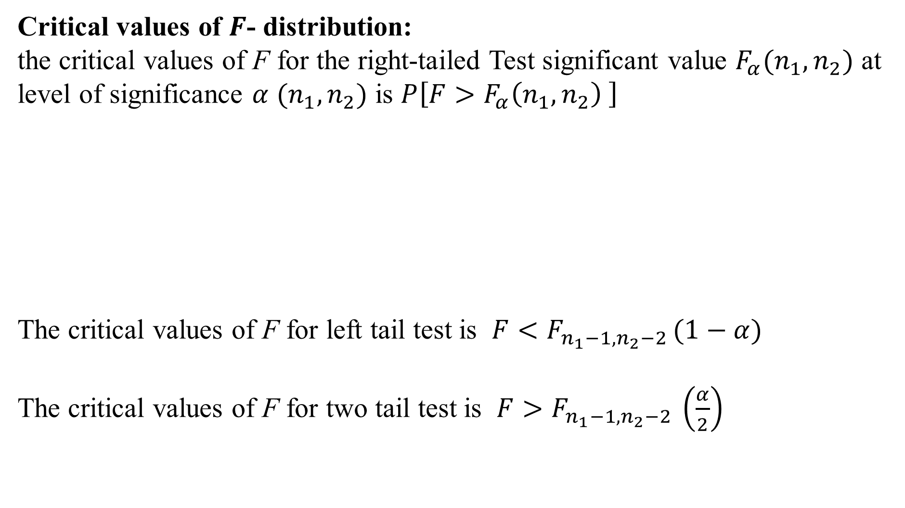
Critical values of $F$- distribution:
the critical values of F for the right-tailed Test significant value $F_{α}(n_{1},n_{2})$ at level of significance $α$ $(n_{1},n_{2})$ is $P\left[F>F_{α}\left(n_{1},n_{2}\right) \right]$
The critical values of F for left tail test is $F<F_{n_{1}−1, n_{2}−2 }(1−α)$
The critical values of F for two tail test is $F>F_{n_{1}−1, n_{2}−2 }\left(\frac{α}{2}\right)$

Slide 25
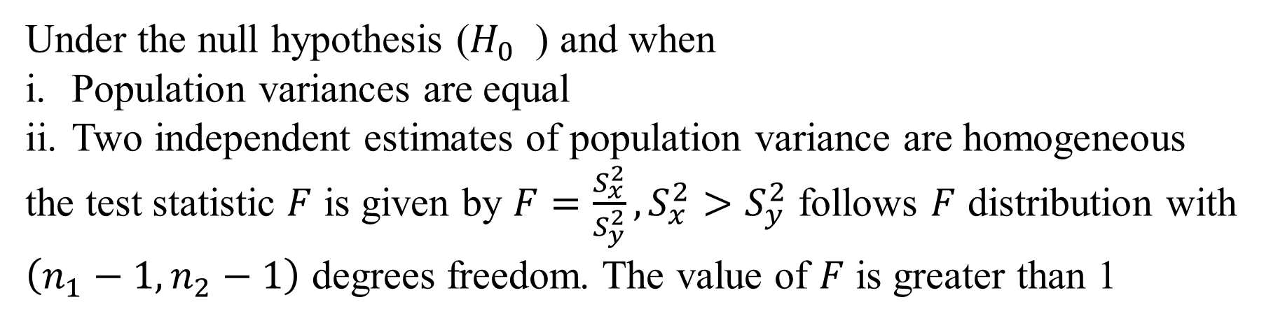
Under the null hypothesis ($H_{0}$ ) and when
Population variances are equal
Two independent estimates of population variance are homogeneous
the test statistic $F$ is given by $F=\frac{S_{x}^{2}}{S_{y}^{2}}, S_{x}^{2}>S_{y}^{2}$ follows $F$ distribution with $\left(n_{1}−1, n_{2}−1\right)$ degrees freedom. The value of $F$ is greater than 1

Slide 26
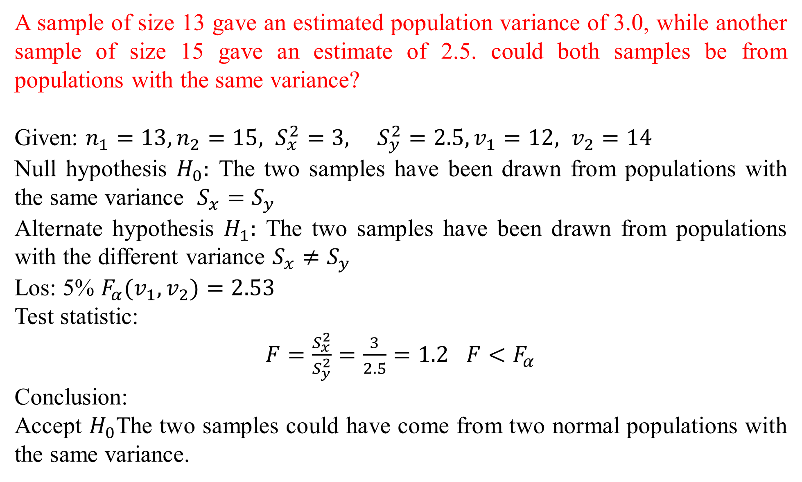
A sample of size 13 gave an estimated population variance of 3.0, while another sample of size 15 gave an estimate of 2.5. could both samples be from populations with the same variance?
Given: $n_{1}=13, n_{2}=15, S_{x}^{2}=3, S_{y}^{2}=2.5, v_{1}=12, v_{2}=14$
Null hypothesis $H_{0}:$ The two samples have been drawn from populations with the same variance $S_{x}=S_{y}$
Alternate hypothesis $H_{1}:$ The two samples have been drawn from populations with the different variance $S_{x}≠S_{y}$
Los: 5% $F_{α}(v_{1}, v_{2})=2.53$
Test statistic:
$F=\frac{S_{x}^{2}}{S_{y}^{2}}=\frac{3}{2.5}=1.2$ $F<F_{α}$
Conclusion:
Accept $H_{0}$The two samples could have come from two normal populations with the same variance.

Slide 27
Two independent samples of 8 and 7 items respectively had the following values of the variable:
Does the estimate of Population variance differ significantly? Given that for 7 degrees of freedom, the value of F at a 5 % level of significance is 4.20 nearly
Sample I | 9 | 11 | 13 | 11 | 15 | 9 | 12 | 14
Sample II | 10 | 12 | 10 | 14 | 9 | 8 | 10

Slide 28
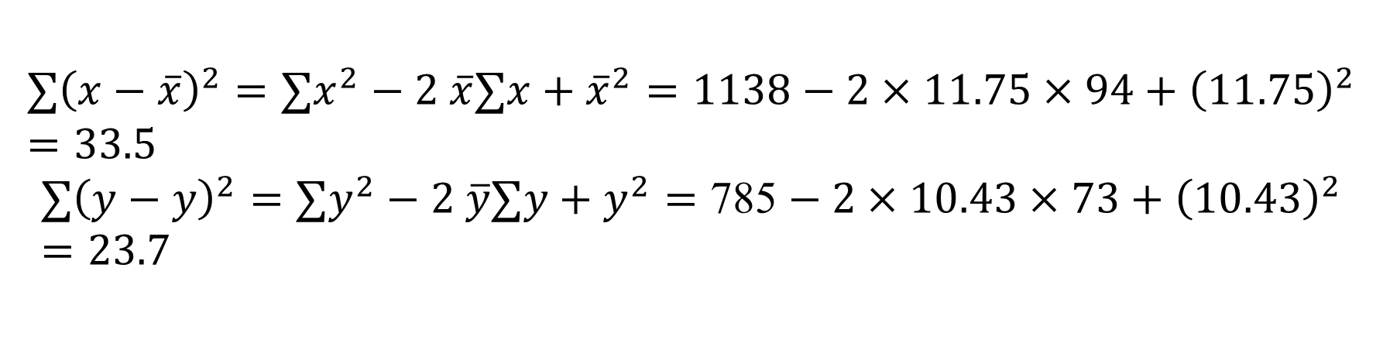
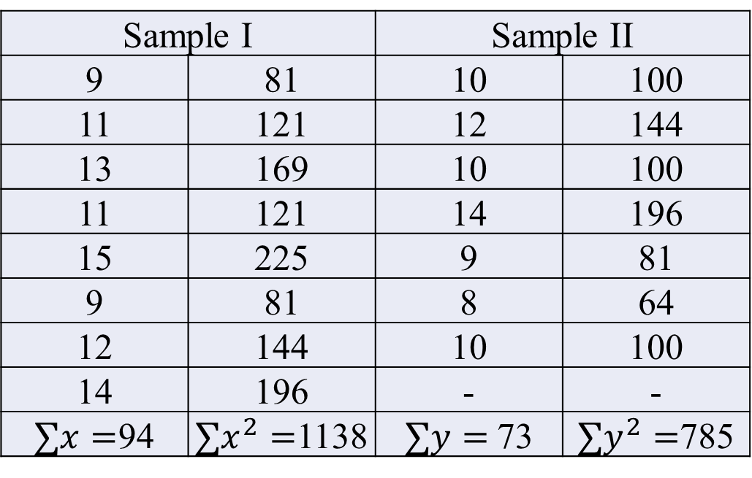
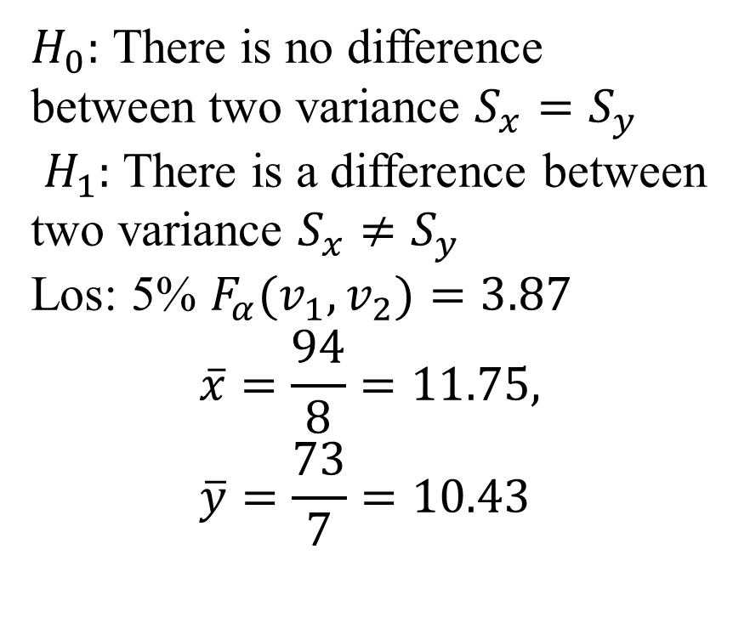
$H_{0}:$ There is no difference between two variance $S_{x}=S_{y}$
$H_{1}:$ There is a difference between two variance $S_{x}≠S_{y}$
Los: 5% $F_{α}(v_{1}, v_{2})=3.87$
$$\overline{x}=\frac{94}{8}=11.75, \overline{y}=\frac{73}{7}=10.43$$
Sample I |  | Sample II
9 | 81 | 10 | 100
11 | 121 | 12 | 144
13 | 169 | 10 | 100
11 | 121 | 14 | 196
15 | 225 | 9 | 81
9 | 81 | 8 | 64
12 | 144 | 10 | 100
14 | 196 | - | -
$∑x=$94 | $∑x^{2}=$1138 | $∑y=$73 | $∑y^{2}=$785
$$∑{\left(x−\overline{x}\right)}^{2}=∑x^{2}−2 \overline{x}∑x+{\overline{x}}^{2}=1138−2×11.75×94+{\left(11.75\right)}^{2}=33.5$$
$$∑{\left(y−y\right)}^{2}=∑y^{2}−2 \overline{y}∑y+y^{2}=\text{785}−2×10.43×73+{\left(10.43\right)}^{2}=23.7$$

Slide 29
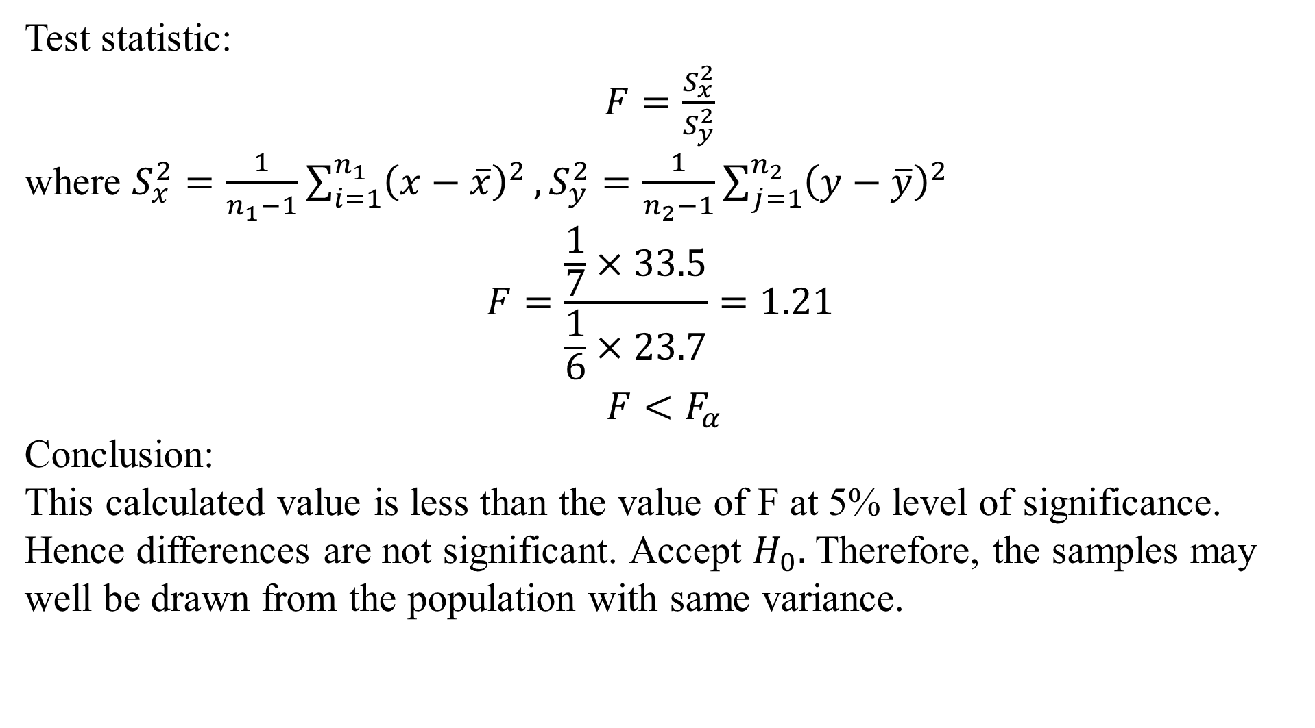
Test statistic:
$F=\frac{S_{x}^{2}}{S_{y}^{2}}$
where $S_{x}^{2}=\frac{1}{n_{1}−1}\sum_{i=1}^{n_{1}}{{\left(x−\overline{x}\right)}^{2}},S_{y}^{2}=\frac{1}{n_{2}−1}\sum_{j=1}^{n_{2}}{{\left(y−\overline{y}\right)}^{2}}$
$$F=\frac{\frac{1}{7}×33.5}{\frac{1}{6}×23.7}=1.21$$
$$F<F_{α}$$
Conclusion:
This calculated value is less than the value of F at 5% level of significance.
Hence differences are not significant. Accept $H_{0}.$ Therefore, the samples may well be drawn from the population with same variance.

Slide 30
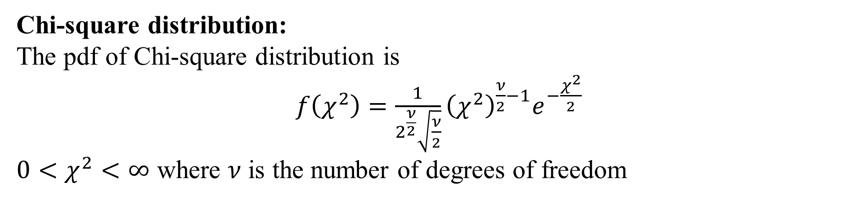
Chi-square distribution:
The pdf of Chi-square distribution is
$f\left(χ^{2}\right)=\frac{1}{2^{\frac{ν}{2}}\sqrt{\frac{ν}{2}}}{\left(χ^{2}\right)}^{\frac{ν}{2}−1}e^{−\frac{χ^{2}}{2} }$
$0<χ^{2}<∞$ where $ν$ is the number of degrees of freedom

Slide 31
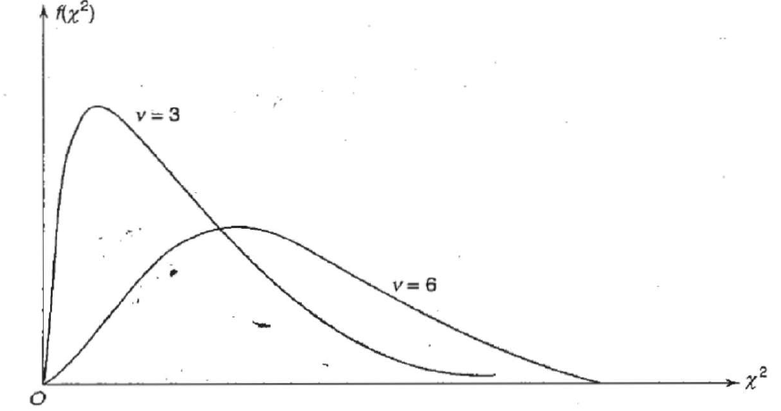
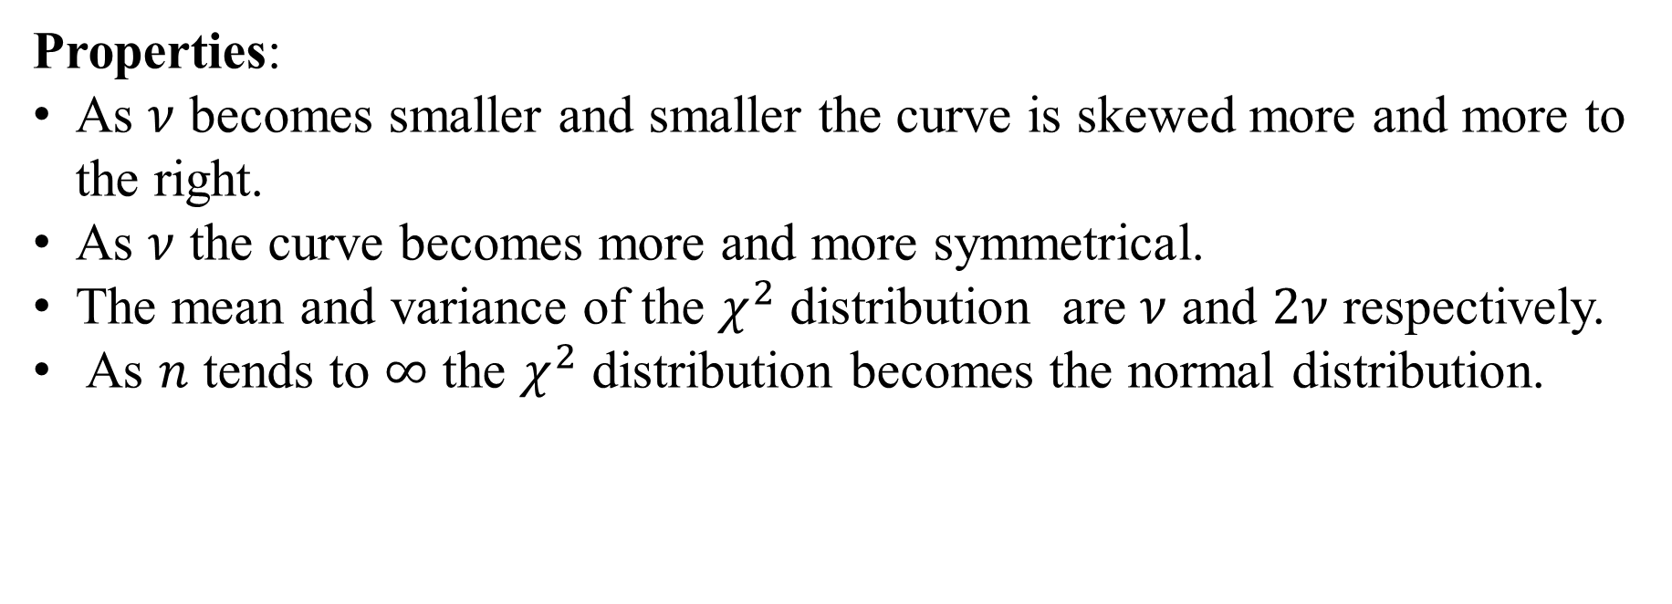
Properties:
As $ν$ becomes smaller and smaller the curve is skewed more and more to the right.
As $ν$ the curve becomes more and more symmetrical.
The mean and variance of the $χ^{2}$ distribution are $ν$ and $2ν$ respectively.
As $n$ tends to $∞$ the $χ^{2}$ distribution becomes the normal distribution.

Slide 32
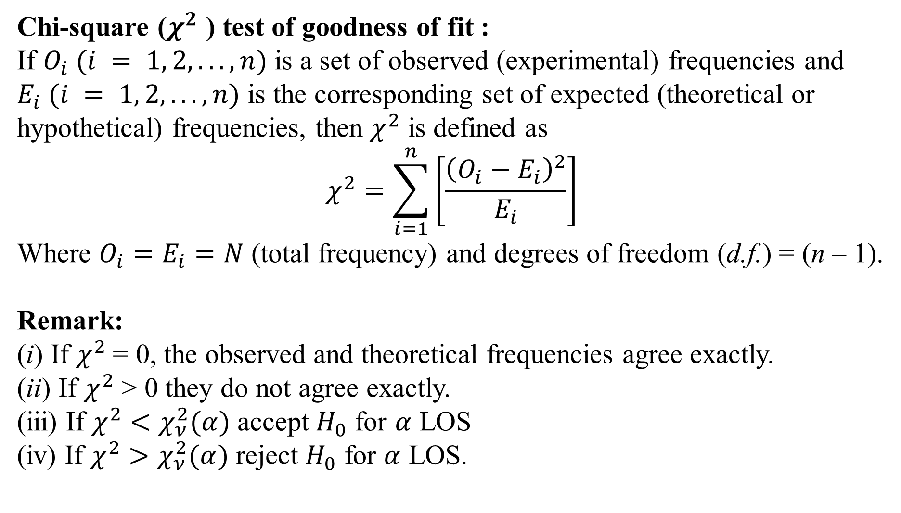
Chi-square ($χ^{2}$ ) test of goodness of fit :
If $O_{i} (i = 1, 2, . . . , n)$is a set of observed (experimental) frequencies and $E_{i} (i = 1, 2, . . . , n)$ is the corresponding set of expected (theoretical or hypothetical) frequencies, then $χ^{2}$ is defined as
$$χ^{2}=\sum_{i=1}^{n}{\left[\frac{{\left(O_{i}−E_{i}\right)}^{2}}{E_{i}}\right]}$$
Where $O_{i}=E_{i}=N$ (total frequency) and degrees of freedom (d.f.) = (n – 1).
Remark:
(i) If $χ^{2}$= 0, the observed and theoretical frequencies agree exactly.
(ii) If $χ^{2}$ > 0 they do not agree exactly.
(iii) If $χ^{2}<χ_{ν}^{2}(α)$ accept $H_{0}$ for $α$ LOS
(iv) If $χ^{2}>χ_{ν}^{2}(α)$ reject $H_{0}$ for $α$ LOS.

Slide 33
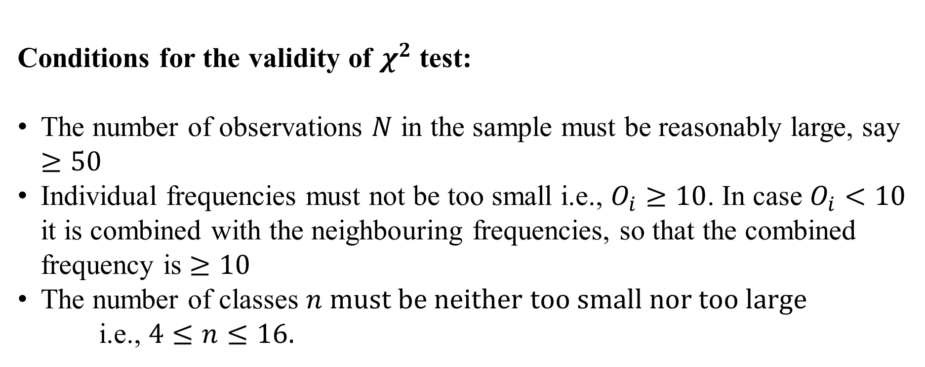
Conditions for the validity of $χ^{2}$ test:
The number of observations $N$ in the sample must be reasonably large, say $≥50$
Individual frequencies must not be too small i.e., $O_{i}≥10$. In case $O_{i}<10$ it is combined with the neighbouring frequencies, so that the combined frequency is $≥10$
The number of classes $n must be neither too small nor too large$
i.e., $4≤n≤16.$

Slide 34
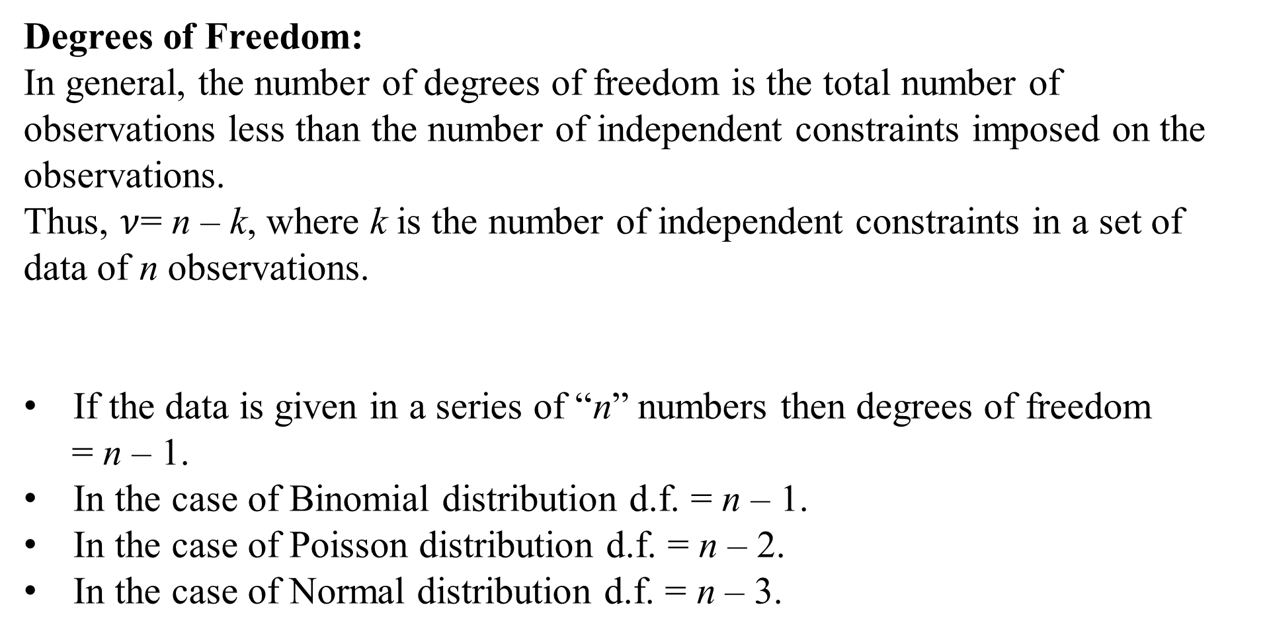
Degrees of Freedom:
In general, the number of degrees of freedom is the total number of observations less than the number of independent constraints imposed on the observations.
Thus, $ν$= n – k, where k is the number of independent constraints in a set of data of n observations.
If the data is given in a series of “n” numbers then degrees of freedom
= n – 1.
In the case of Binomial distribution d.f. = n – 1.
In the case of Poisson distribution d.f. = n – 2.
In the case of Normal distribution d.f. = n – 3.

Slide 35
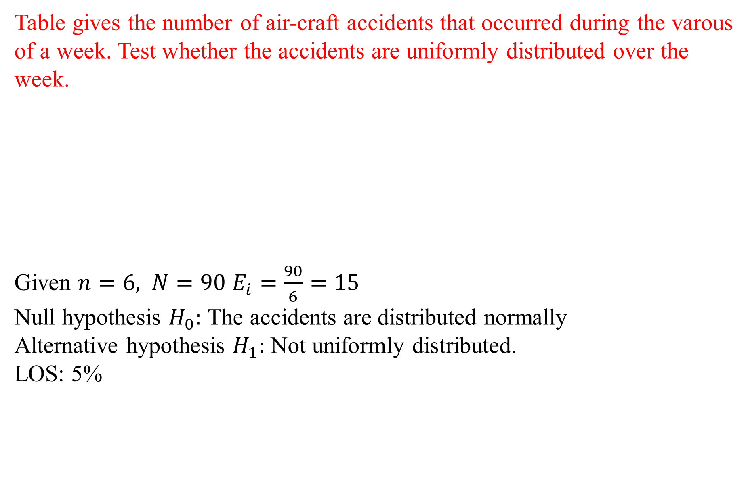
Table gives the number of air-craft accidents that occurred during the varous of a week. Test whether the accidents are uniformly distributed over the week.
Given $n=6,$ $N=90$ $E_{i}=\frac{90}{6}=15$
Null hypothesis $H_{0}:$ The accidents are distributed normally
Alternative hypothesis $H_{1}:$ Not uniformly distributed.
LOS: 5%
Day | Mon | Tue | Wed | Thu | Fri | Sat
No of accidents | 15 | 19 | 13 | 12 | 16 | 15

Slide 36
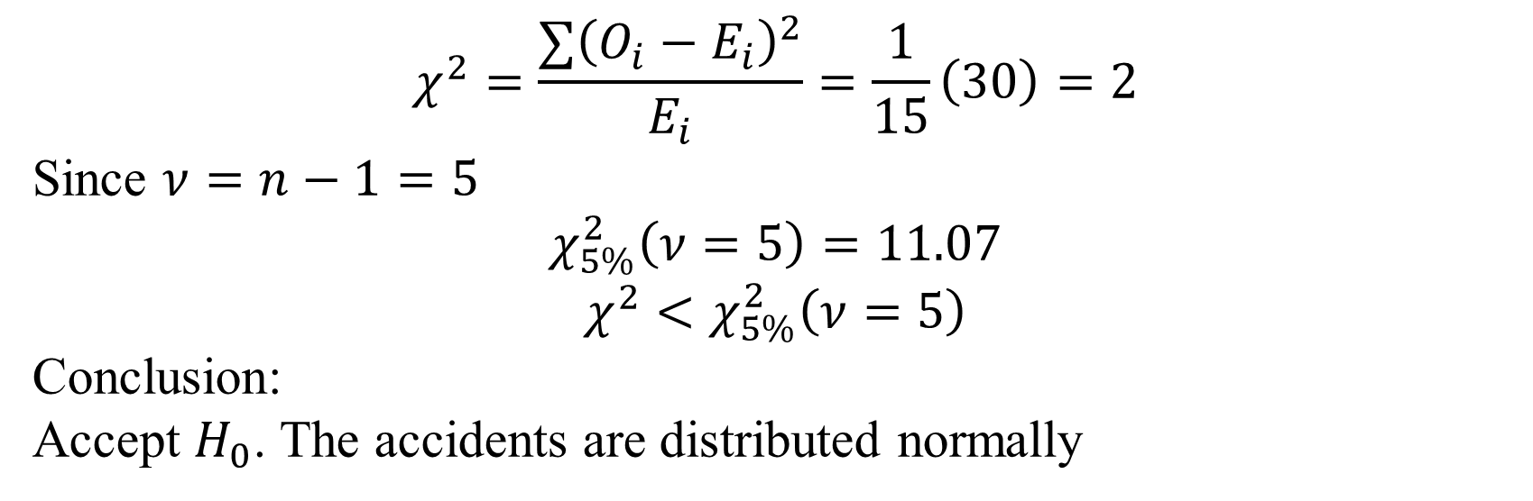
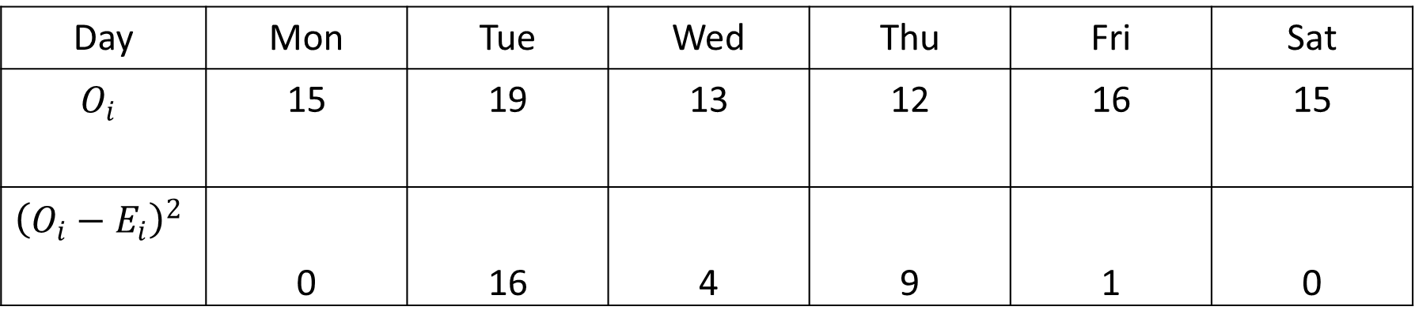
Day | Mon | Tue | Wed | Thu | Fri | Sat
$$O_{i}$$ | 15 | 19 | 13 | 12 | 16 | 15
$${\left(O_{i}−E_{i}\right)}^{2}$$ | 0 | 16 | 4 | 9 | 1 | 0
$$χ^{2}=\frac{∑{\left(O_{i}−E_{i}\right)}^{2}}{E_{i}}=\frac{1}{15}\left(30\right)=2$$
Since $ν=n−1=5$
$$χ_{5\%}^{2}\left(ν=5\right)=11.07$$
$$χ^{2}<χ_{5\%}^{2}\left(ν=5\right)$$
Conclusion:
Accept $H_{0}$. The accidents are distributed normally

Slide 37
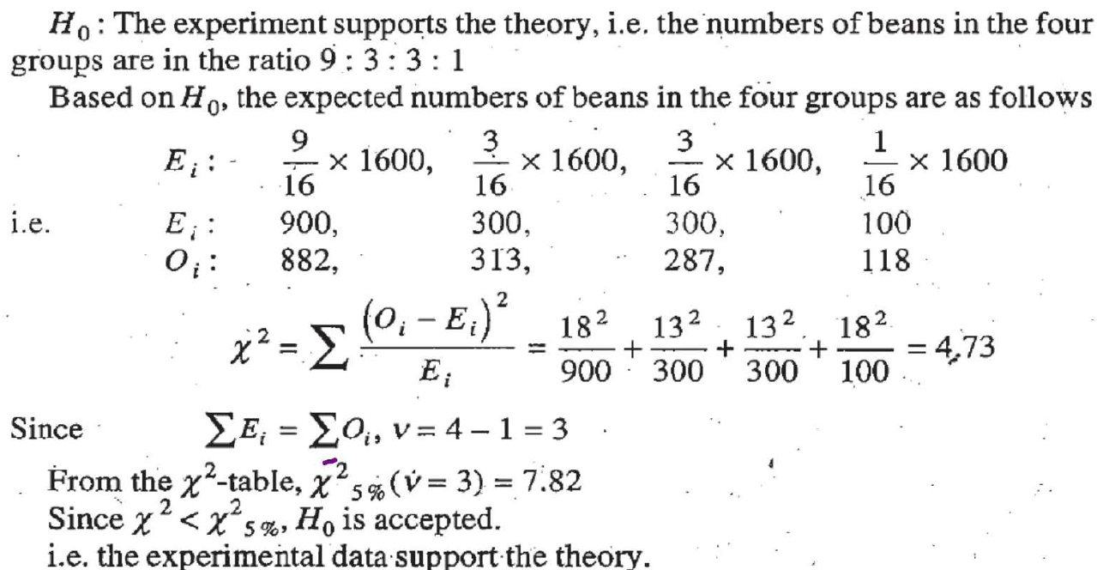

Slide 38
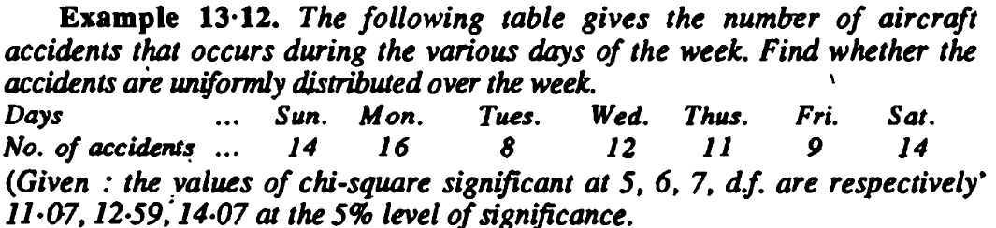



Slide 39
A survey of 320 families with 5 children each revealed the following distribution:
Is this result consistent with the hypothesis that male and female births are equally probable?
No of boys | 5 | 4 | 3 | 2 | 1 | 0
No of girls | 0 | 1 | 2 | 3 | 4 | 5
No of families | 14 | 56 | 110 | 88 | 40 | 12

Slide 40
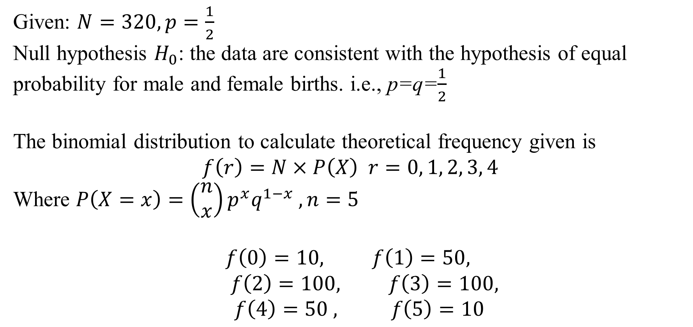
Given: $N=320, p=\frac{1}{2}$
Null hypothesis $H_{0}$: the data are consistent with the hypothesis of equal probability for male and female births. i.e., p=q=$\frac{1}{2}$
The binomial distribution to calculate theoretical frequency given is
$$f\left(r\right)=N×P\left(X\right) r=0, 1, 2, 3, 4$$
Where $P\left(X=x\right)=\left(\begin{matrix}n \\ x\end{matrix}\right)p^{x}q^{1−x} , n=5$
$$f\left(0\right)=10, f\left(1\right)=50,$$
$$f\left(2\right)=100, f\left(3\right)=100,$$
$f\left(4\right)=50 , f\left(5\right)=10$

Slide 41
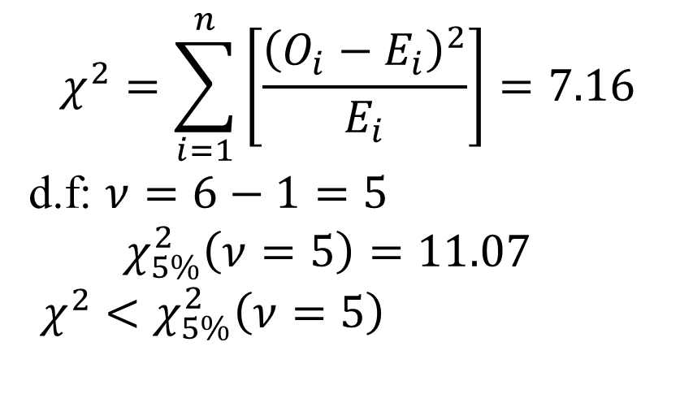
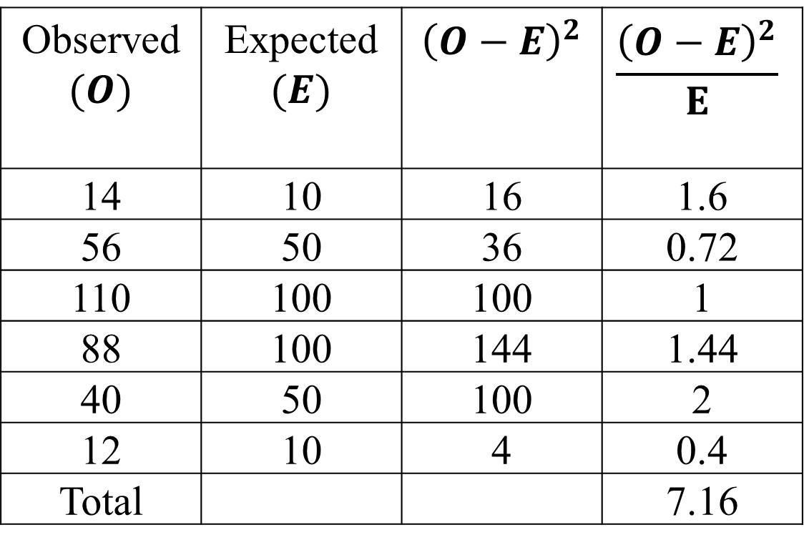
$$χ^{2}=\sum_{i=1}^{n}{\left[\frac{{\left(O_{i}−E_{i}\right)}^{2}}{E_{i}}\right]}=7.16$$
d.f: $ν=6−1=5$
$χ_{5\%}^{2}\left(ν=5\right)=11.07$
$χ^{2}<χ_{5\%}^{2}\left(ν=5\right)$
Observed $(O)$ | Expected $(E)$ | $${\left(O−E\right)}^{2}$$ | $$\frac{{\left(O−E\right)}^{2}}{E}$$
14 | 10 | 16 | 1.6
56 | 50 | 36 | 0.72
110 | 100 | 100 | 1
88 | 100 | 144 | 1.44
40 | 50 | 100 | 2
12 | 10 | 4 | 0.4
Total |  |  | 7.16
Conclusion: it is not significant at 5% level of significance and hence the null hypothesis of equal probability for male and female births may be accepted.

Slide 42
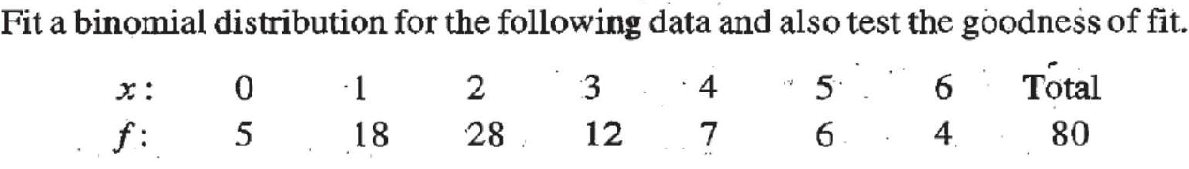

Slide 43
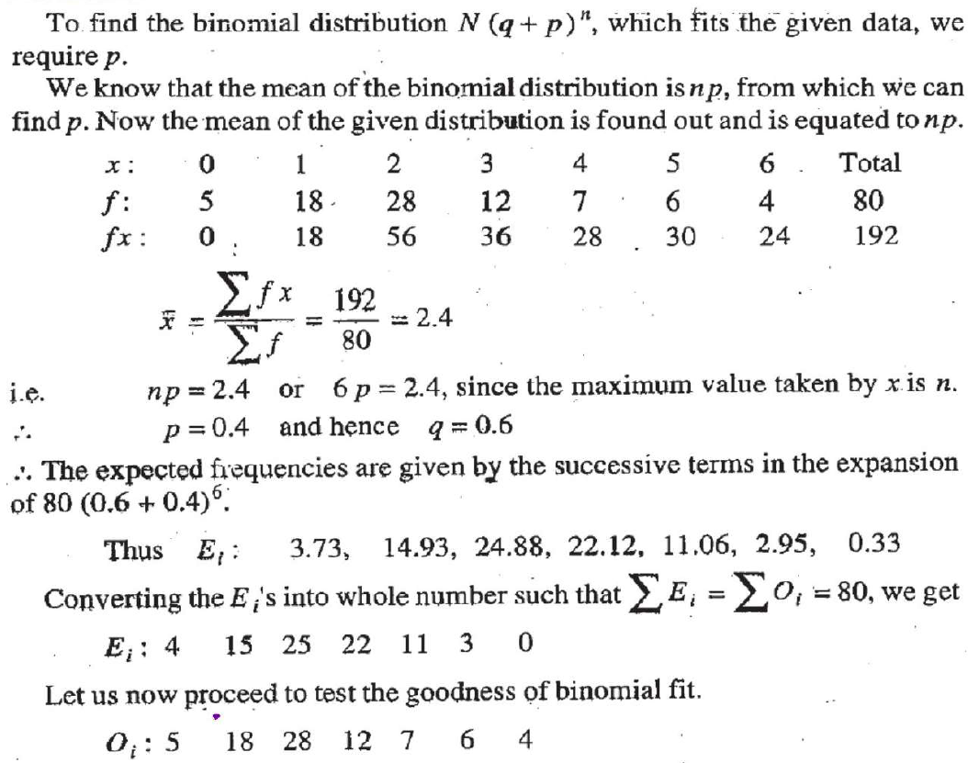

Slide 44
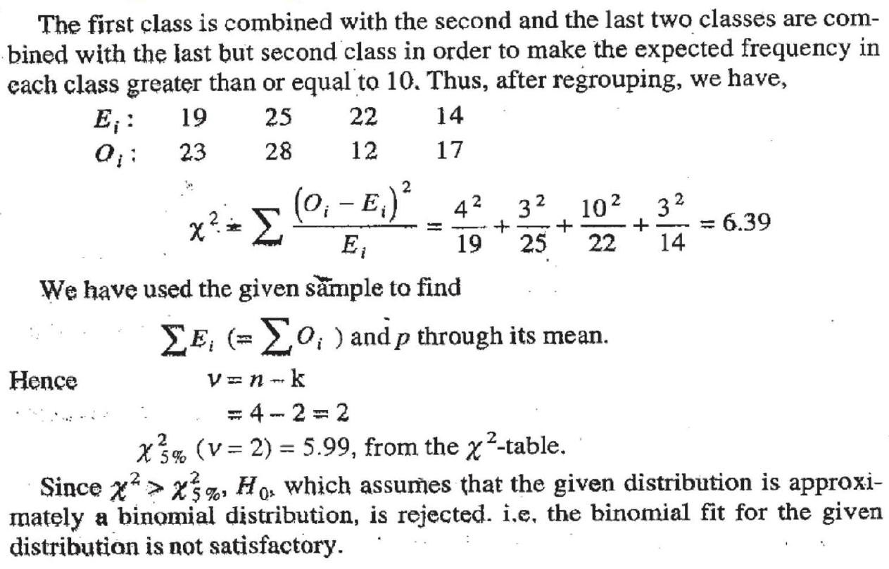

Slide 45
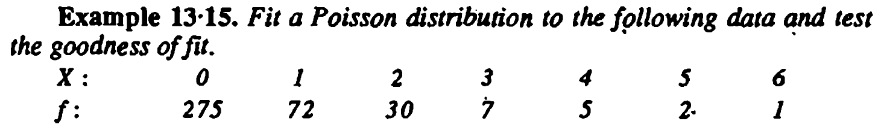
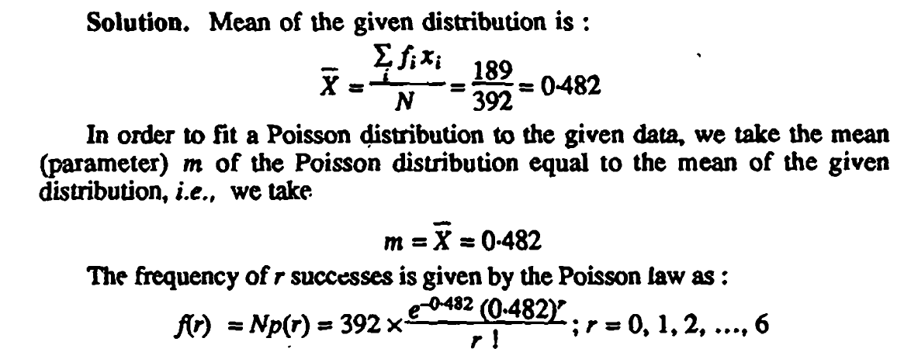


Slide 46


Slide 47




Slide 48


Slide 49
The χ2 Test as a Test of Independence:
With the help of the χ2 test, we can find whether or not two attributes are associated. We take the null hypothesis that there is no association between the attributes under study, i.e., we assume that the two attributes are independent. If the calculated value of χ2 is less than the table value at a specified level (generally 5%) of significance, the hypothesis holds true, i.e., the attributes are independent and do not bear any association. On the other hand, if the calculated value of χ2 is greater than the table value at a specified level of significance, we say that the results of the experiment do not support the hypothesis. In other words, the attributes are associated. Thus a very useful application of the χ2 test is to investigate the relationship between trials or attributes, which can be classified into two or more categories.

Slide 50


The sample data are set out into a two-way table called a contingency table. Let us consider two attributes A and B divided into r classes $A_{1}, A_{2}, A_{3}, . . . , A_{r}$and B divided into s classes $B_{1}, B_{2}, B_{3}, . . . , B_{s}$. If ($A_{i}$), ($B_{j}$) represents the number of people possessing the attributes $A_{i}$, $B_{j}$ respectively, (i = 1, 2, . . . , r, j = 1, 2, . . . , s) and ($A_{i}$ $B_{j}$) represent the number of people possessing attributes $A_{i}$ and $B_{j}$. Also we have total frequency. The contingency table for r × s is given below:

Slide 51


Slide 52



Slide 53

Two sample polls of votes for two candidates A and B for a public office are taken. One from among the residents of rural areas. The results are given in the table. Examine whether the nature of the area is related to voting preference
in' this election.

Slide 54


Slide 55


Slide 56


Slide 57



Slide 58

A random sample of students of Bombay University was selected and asked their opinions about ‘autonomous colleges’. The results are given below. The same number of each sex was included within each class group. Test the hypothesis at 5% level that opinions are independent of the class groupings:

Slide 59


Slide 60


Slide 61
Design of Experiments:
A statistical experiment in any field is performed to verify a particular hypothesis.
For Example, an agricultural experiment may be performed to verify the claim that a particular manure has got the effect of increasing the yield of paddy. Here the quantity of the manure used and the amount of yield are the two variables involved directly are called as experimental variables.
Fertility of the soil, the quantity of the seed used and the amount of rainfall, which also effect the yield of paddy, extraneous variables.
Main Objective: To control the extraneous variables and hence to minimise the experimental error so that the results of the experiments could be attributed only to the experimental variables.

Slide 62
Principles of Experimental Design
Randomisation
Replication
Local Control
Analysis of Variance (ANOVA)
It is a powerful statistical tool in tests of significance. In parametric tests, we discussed the statistical tests relating to mean of a population or equality of means of two populations.
In situations, when we have three or more samples to consider at a time, an alternative procedure is needed for testing the hypothesis that all the samples are drawn from the same populations, which have the same mean.

Slide 63
Analysis of variance (ANOVA) was introduced by R.A. Fisher to deal the problem in the analysis of agricultural data. Variations in the observations are inherent in nature. The total variation in the observed data is due to the following two causes namely, (i) assignable causes, and (ii) chance causes.
By this technique, the total variation in the sample data can be bifurcated into variation between sample and variation within samples. The second kind of variation is due to experimental error.
Treatments:
Various factors or methods that we adopted in a comparative experiment are termed as treatments. For example, in field experiments, different varieties of paddy seeds, different kinds of fertilizers, different methods of cultivation etc., are called treatments.

Slide 64
2. Experimental Unit
A small area of experimental material is used for applying the treatment is called an experimental unit.
In agricultural experiments, a cultivated land, usually called as experimental material is divided into smaller areas of plots in which, different treatment can be applied in it. Such kind of plots are called experimental units.
3. Blocks
In field experiments, the experimental material is firstly divided into relatively homogeneous divisions, known as Blocks. All the blocks are further divided into small plots of experimental units.

Slide 65

One-way ANOVA or Completely Randomized Design:
Aim:
To test the significance of the $t−$ treatment effects based on the observations from $n−$ experimental units.
Source:
Let $yij$, (i = 1, 2,…, t; j = 1, 2,…, r) be the observations of $t−$ treatments, each replicated with (equal number of replications) $r$- times in $n−$ experimental units (i.e., $n = tr$).
In this design, treatments are allocated at random to the experimental units over the entire experimental material. That is, the entire experimental material is divided into $n$ experimental units and the treatments are distributed completely at random over the units.

Slide 66

Null Hypothesis $\left(H_{0 }\right):$ The $k−$ treatments have equal effect.
i.e., $τ_{1}=τ_{2}=…=τ_{k}$
Alternative Hypothesis $\left(H_{1}\right)$: The $k−$ treatments do not have equal effect.
i.e., $τ_{1}≠τ_{2}≠…≠τ_{k}$
Level of Significance ($α$) and Critical Region ( $Fα$)
$F>F_{α, (k−1, n−k)}$ such that P [$F>F_{α, (k−1, n−k)}$] = $α$
The critical values of F at level of Significance $α$ and degrees of freedom
(k$–1$, $n–k$), are obtained from Table.

Slide 67

Method:
Grand total of the all the observations, $G=\sum_{i=1}^{k}{\sum_{j=1}^{r}{ y_{ij}}}$
Correction Factor, CF = ${G^{2}}/n$
Total Sum of Squares, $TSS=\sum_{i=1}^{k}{\sum_{j=1}^{r}{ y_{ij}^{2}−CF}}$
Sum of Squares between treatments, $SSTr=\frac{1}{r}\sum_{i=1}^{k}{T_{i}^{2}−CF}$
$T_{i}$ - total of the $i^{th}$- treatment observations from all the replications(r).
Error Sum of Squares (Sum of Squares within treatments), ESS = TSS – SSTr

Slide 68


Anova Table:
Conclusion:
If $\left|F_{cal}\right|≤$ $\left|F_{α, (k−1, n−k)}\right|$, we conclude that the data do not provide us any evidence against the null hypothesis H₀, and hence it may be accepted at $α\%$ level of significance. Otherwise reject H₀ or accept H₁.
Source of Variation | Degrees of freedom | Sum of Squares | Mean Sum of Squares | F-statistic
Treatments | $$k−1$$ | $$SSTr$$ | $$𝓈_{Tr}^{2}=\frac{SSTr}{k−1}$$ | $$F=\frac{𝓈_{Tr}^{2}}{𝓈_{E}^{2}}$$
Error | $$n−k$$ | $$SSE$$ | $$𝓈_{E}^{2}=\frac{SSTr}{n−k}$$
Total | $$n−1$$ | $$TSS$$

Slide 69
The following data denotes the four “tropical feed stuffs A, B, C, D” tried on 20 chicks is given below. All the twenty chicks are treated alike in all respects except the feeding treatments and each feeding treatment is given to five chicks. Test whether all the four feedstuffs are alike in weight gain of the chicks at 5% level of significance.
A | 55 | 49 | 42 | 21 | 52
B | 61 | 112 | 30 | 89 | 63
C | 42 | 97 | 81 | 95 | 92
D | 169 | 137 | 169 | 85 | 154

Slide 70

Aim: To test all the four feedstuffs are equal in weight gain of chicks.
H₀: The four feedstuffs are equal in weight gain of chicks.
H₁: The four feedstuffs are not equal in weight gain of chicks.
Level of Significance: $α$ = 0.05
Number of treatments, $k=4$ & n = 20
$T1$ $= 219$, $T2 = 355$, $T3 = 407$, $T4 = 714$
Grand Total, $G = 1695$
$$CF = {1695}^{2}/20 = 143651.25$$

Slide 71

TSS = $552+…+1542 – CF$= 181445 – 143651.25 = 37793.75
SSTr = $\frac{1}{5}$(219² + … + 714²) $–$ CF = 26234.95
ESS = $TSS – SSTr$= 11558.80
Critical value: F_{0.05, (3,16)} = 3.24
Anova Table:
Source of Variation | Degrees of freedom | Sum of Squares | Mean Sum of Squares | F-statistic
Treatments | 3 | 26234.95 | 8744.98 | 12.11
Error | 16 | 11558.80 | 722.42
Total | 19 | 37793.75 | -

Slide 72
Conclusion: Since F > F_{0.05, (3,16)}, we conclude that the data provide us evidence against the null hypothesis H₀ and in favor of H₁. Hence, H₁ is accepted at 5% level of significance. That is, the four feedstuffs are not equal in weight gain of chicks.

Slide 73

Two-way ANOVA & Randomized Block Design:
Aim:
To test the significance of the k treatment effects and the significance of the r block effects based on the observations from n experimental units.
Null Hypotheses:
H₀(1): The k treatments have equal effect. i.e., H₀: t₁ = t₂ = … = t_{k}.
H₀(2): The r blocks have equal effect. i.e., H₀: b₁ = b₂ = … = b_{r}.
Alternative Hypotheses:
H₁(1): The k treatments do not have equal effect.
i.e., H₁: t₁ $≠$ t₂ $≠$ … $≠$ t_{k}.
H₁(2): The r blocks do not have equal effect.
i.e., H₁ : b₁ $≠$ b₂ $≠$ … $≠$ b_{r}.

Slide 74

Level of Significance ($α$) and Critical Region ( $Fα$):
$F1>F_{α, (k−1), (k−1)(r−1)}$ such that
P [$F1>F_{α, (k−1), (k−1)(r−1)}$] = $α$.
$F2>F_{α, (r−1), (t−1)(r−1)}$ such that
P [$F2>F_{α, (r−1), (k−1)(r−1)}$] = $α$.
The critical values of F at level of Significance $α$ and degrees of freedom
$\left[\text{(}\text{k}\text{–1),} \text{(}\text{k}\text{−1) (}\text{r}\text{−1)}\right]$and for $\left[\text{(}\text{r}\text{–1), (}\text{k}\text{−1) (}\text{r}\text{−1)}\right]$, are obtained from Table.

Slide 75

Method:
Grand total of the all the observations, $G=\sum_{i=1}^{k}{\sum_{j=1}^{r}{ y_{ij}}}$
Correction Factor, CF = ${G^{2}}/n$
Total Sum of Squares, $TSS=\sum_{i=1}^{k}{\sum_{j=1}^{r}{ y_{ij}^{2}−CF}}$
Sum of Squares between treatments, $SSTr=\frac{1}{r}\sum_{i=1}^{k}{T_{i}^{2}−CF}$
$T_{i}$ - total of the $i^{th}$- treatment observations from all the replications.
Sum of Squares between blocks, SSB = $\frac{1}{k}\sum_{j=1}^{r}{B_{j}^{2}−CF}$
$B_{j}$ - total of the $j^{th}$- block observation.

Slide 76


Error Sum of Squares (Sum of Squares within treatments), ESS = TSS – SSTr $−SSB$
Anova Table:
Source of Variation | Degrees of freedom | Sum of Squares | Mean Sum of Squares | F-statistic
Treatments | $$k−1$$ | $$SSTr$$ | $$𝓈_{tr}^{2}={SSTr}/{k−1}$$ | $$F1={𝓈_{tr}^{2}}/{𝓈_{E}^{2}}$$
Blocks | $$r−1$$ | $$SSB$$ | $$𝓈_{B}^{2}={SSB}/{r−1}$$ | $$F2={𝓈_{B}^{2}}/{𝓈_{E}^{2}}$$
Error | $$(k−1) (r−1)$$ | $$ESS$$ | $$𝓈_{E}^{2}={ESS}/{\text{(}\text{k}\text{−1) (}\text{r}\text{−1) }}$$
Total | $$n−1$$ | $$TSS$$

Slide 77
The following result shows the yield of three varieties of paddy manure in four plots each using RBD layout
Block | Paddy varieties |  |  | Total
 | ADT36 | IR20 | PONNI
I | 46.2 | 48.5 | 54.3 | 149
II | 48.4 | 52.6 | 57.0 | 158
III | 44.3 | 51.4 | 53.3 | 149
IV | 49.1 | 53.5 | 51.4 | 154
Total | 188 | 206 | 216 | 610

Slide 78

Aim:
To test the yield of all the three varieties of paddy are equal.
To test the yield in all the four blocks are equal.
Null hypothesis:
$H_{0}\left(1\right):$ The yields of all the three varieties of paddy are homogeneous.
$H_{0}\left(2\right):$ The yields yield in all the four blocks are homogeneous.
Alternative hypothesis:
$H_{1}\left(1\right):$ The yields of all the three varieties of paddy are not homogeneous.
$H_{1}\left(2\right):$ The yields yield in all the four blocks are not homogeneous.
Level of significance: $α=0.05$
Number of treatment $t=3$, Number of Blocks $r=4$
Grand total: $G=610$
$$CF:\frac{{610}^{2}}{12}=31008.33$$

Slide 79


$$TSS={46.2}^{2}+{48.4}^{2}+…+53..3^{2}+{51.4}^{2}−CF=31153.86−31008.33=145.53$$
$$SST=\frac{1}{4}\left({188}^{2}+{206}^{2}+{216}^{2}\right)−CF=100.67$$
$$BSS=\frac{1}{3}\left({149}^{2}+{158}^{2}+{149}^{2}+{154}^{2}\right)−CF=19.003$$
$$ESS=TSS−SST−BSS=25.847$$
Source of Variation | Degrees of freedom | Sum of squares | Mean sum of squares | F-statistic
Treatments | 2 | 100.67 | 50.335 | $$F_{1}=11.68$$
Blocks | 3 | 19.003 | 6.334 | $$F_{2}=1.47$$
Error | 6 | 25.857 | 4.3095
Total | 11 | 145.53

Slide 80

Critical values: $F_{0.05, (2, 6)}=5.14$ and $F_{0.05, (3, 6)}=4.76$
Conclusion:
Since $F_{1}>F_{0.05, (2, 6)}$, we conclude that the data provide us any evidence against the null hypothesis $H_{0}\left(1\right)$ and in favour of $H_{1}\left(1\right)$ is accepted at 5% level of significance. i.e., the yields of all the three verities of paddy are not homogeneous.
Since $F_{2}>F_{0.05, (3, 6)}$, we conclude that do not provide us any evidence against the null hypothesis $H_{0}\left(2\right)$ and hence it may be accepted at 5% level of significance. i.e., the yields in all the four blocks are homogeneous.

Slide 81

Three way ANOVA (or) Latin Square Design ( LSD ):
Aim:
To test the significance of the $m$ treatment effects, $m$ row effects and $m$ column effects based on the observations from $m$ square $\left(m^{2}\right)$ experimental units.
Null hypothesis:
$H_{0}\left(1\right):$ The $m$ treatments have equal effect. i.e., $H_{0}\left(1\right):τ_{1}=τ_{2}=…=τ_{m}$
$H_{0}\left(2\right):$ The $m$ treatments have equal effect. i.e., $H_{0}\left(2\right):β_{1}=β_{2}=…=β_{m}$
$H_{0}\left(3\right):$ The $m$ treatments have equal effect. i.e., $H_{0}\left(3\right):ν_{1}=ν_{2}=…=ν_{m}$
Alternate hypothesis:
$H_{1}\left(1\right):$ The $m$ treatments do not have equal effect. i.e., $H_{1}\left(1\right):τ_{1}≠τ_{2}≠…≠τ_{m}$
$H_{1}\left(2\right):$ The $m$ treatments do not have equal effect. i.e., $H_{1}\left(2\right):β_{1}≠β_{2}≠…≠β_{m}$
$H_{1}\left(3\right):$ The $m$ treatments do not have equal effect. i.e., $H_{1}\left(3\right):ν_{1}≠ν_{2}≠…≠ν_{m}$

Slide 82

Level of significance $(α)$ and Critical Region:
$F_{i}>F_{α, (m−1), (m−1)(m−2)}$ such that
P [$F1>F_{α, (m−1), (m−1)(m−2)}$] = $α$
for $i=1, 2, 3$. The critical values of $F$ at level of significance $α$ and degrees of freedom $\left(m−1, \left(m−1\right)\left(m−2\right)\right)$ are obtained from table.

Slide 83

Method:
Grand total of the all the observations, $G=\sum_{i=1}^{k}{\sum_{j=1}^{r}{ y_{ij}}}$
Correction Factor, CF = ${G^{2}/m}^{2}$
Total Sum of Squares, $TSS=\sum_{j=1}^{m}{\sum_{k=1}^{m}{ y_{ijk}^{2}−CF}}$
Sum of Squares between treatments, $SST=\frac{1}{m}\sum_{i=1}^{m}{T_{i}^{2}−CF}$
$T_{i}$ - total of the $i^{th}$- treatment observations.
Sum of Squares between rows, SSR =$\frac{1}{m}\sum_{j=1}^{m}{R_{j}^{2}−CF}$
$R_{j}$ - total of the $j^{th}$- row observation.

Slide 84

Sum of Squares between columns, SSC =$\frac{1}{m}\sum_{k=1}^{m}{C_{k}^{2}−CF}$ $C_{k}$ - total of the $k^{th}$- column observation.
Error sum of squares $ESS=TSS−SST−SSR−SSC$

Slide 85

ANOVA table
Source of Variation | Degrees of freedom | Sum of Squares | Mean Sum of Squares | F-statistic
Treatments | $$m−1$$ | $$SST$$ | $${SST}/{m−1}$$ | $$F1=\frac{{SST}/{m−1 }}{\frac{ESS}{\left(m−1\right)\left(m−2\right)}}$$
Rows | $$m−1$$ | $$SSR$$ | $${SSR}/{m−1}$$ | $$F_{2}=\frac{{SSR}/{m−1 }}{\frac{ESS}{\left(m−1\right)\left(m−2\right)}}$$
Columns | $$m−1$$ | $$SSC$$ | $$\frac{ESS}{\left(m−1\right)\left(m−2\right)}$$ | $$F_{3}=\frac{{SSC}/{m−1 }}{\frac{ESS}{\left(m−1\right)\left(m−2\right)}}$$
Error | $$(m−1) (m−2)$$ | $$ESS$$ | $${ESS}/{\text{(}\text{m}\text{−1}\text{) (}\text{m}\text{−2}\text{) }}$$
Total | $$n−1$$ | $$TSS$$

Slide 86

Conclusion:
$F_{i}≤F_{α, \left(m−1\right), \left(m−1\right)\left(m−2\right)},$we conclude that the data do not provide us any evidence against the null hypothesis $H_{0}\left(i\right)$, and hence it may be accepted at $α\%$ level of significance. Otherwise reject $H_{0}\left(i\right)$ or accept $H_{1}\left(i\right)$for $i=1, 2, 3$

Slide 87
An experiment was carried out to determine the effect of claying the ground on the field of barley grains; amount of clay used were as follows. A: No clay, B: Clay at 100 per acre, C: Clay at 200 per acre, D: Clay at 300 per acre. The yields were in plots of 10 square meters and the layout and yields were as follows. Analyze all the effects at 5% level of significance.
Columns Rows | I | II | III | IV | Total
I | D 34.7 | A 35.6 | B 38.2 | C 35.5 | 144
II | C 38.2 | D 34.4 | A 42.8 | B 37.6 | 153
III | A 36.4 | B 37.2 | C 41.7 | D 36.7 | 152
IV | B 39.7 | C 38.8 | D 40.3 | A 38.2 | 157
Total | 149 | 146 | 163 | 148 | 606

Slide 88

Null hypothesis:
$H_{0}\left(1\right):$ The yields under four types of clay are equal.
$H_{0}\left(2\right):$ All the four rows have equal yields.
$H_{0}\left(3\right):$ All the four rows have equal yields.
Alternative hypothesis:
$H_{1}\left(1\right):$ The yields under four types of clay are not equal.
$H_{1}\left(2\right):$ All the four rows do not have equal yields.
$H_{1}\left(3\right):$ All the four rows do not have equal yields.
Level of significance $α=0.05$
$m=4,$ $n=16$, $T_{1}=153, T_{2}=152.7, T_{3}=154.2, T_{4}=146.1$

Slide 89

Grand total of the all the observations, $G=\sum_{i=1}^{k}{\sum_{j=1}^{r}{ y_{ij}}}$= 606
Correction Factor, CF = ${G^{2}/m}^{2}$= $\frac{{606}^{2}}{4^{2}}=22952.25$
Total Sum of Squares, $TSS=\sum_{j=1}^{m}{\sum_{k=1}^{m}{ y_{ijk}^{2}−CF}}$=23038.58-$CF$=86.33
Sum of Squares between treatments, $SST=\frac{1}{m}\sum_{i=1}^{m}{T_{i}^{2}−CF}$=$\frac{1}{4}\left({153}^{2}+…+146.1\right)−CF=10.035$
Sum of Squares between rows, SSR =$\frac{1}{m}\sum_{j=1}^{m}{R_{j}^{2}−CF}=\frac{1}{4}\left({144}^{2}+…{157}^{2}\right)−CF=22.25$

Slide 90

Sum of Squares between columns, SSC =$\frac{1}{m}\sum_{k=1}^{m}{C_{k}^{2}−CF=\frac{1}{4}\left({149}^{2}+…{148}^{2}\right)−CF=45.25}$
Error sum of squares $ESS=TSS−SST−SSR−SSC=8.795$

Slide 91

Source of Variation | Degrees of freedom | Sum of Squares | Mean Sum of Squares | F-statistic
Treatments | $$3$$ | 10.035 | $$3.345$$ | $F1=\frac{{SST}/{m−1 }}{\frac{ESS}{\left(m−1\right)\left(m−2\right)}}$=2.28
Rows | $$3$$ | $$22.25$$ | $$7.4167$$ | $$F_{2}=\frac{{SSR}/{m−1}}{\frac{ESS}{\left(m−1\right)\left(m−2\right)}}=5.06$$
Columns | $$3$$ | $$45.25$$ | $$15.08$$ | $$F_{3}=\frac{{SSC}/{m−1 }}{\frac{ESS}{\left(m−1\right)\left(m−2\right)}}=10.29$$
Error | $$6$$ | $$8.795$$ | $$1.4658$$
Total | $$15$$ | $$86.33$$

Slide 92

Critical value: $F_{0.05, \left(3, 6\right)}=4.76$
Conclusion:
Since $F_{1}<F_{0.05, \left(3, 6\right)}$, we conclude that the data do not provide us any evidence against null hypothesis $H_{0}(1)$, and hence it may be accepted at 5% level of significance. i.e., all four types of clay have equal yields.
Since $F_{2}, F_{3}<F_{0.05, \left(3, 6\right)}$ we conclude that the data do not provide us any evidence against null hypothesis $H_{0}(2)$, $H_{0}(3)$, and in favour of $H_{1}(2)$ and $H_{1}\left(3\right)$. Hence $H_{1}(2)$ and $H_{1}\left(3\right)$ are accepted at 5% level of significance. i.e., all the four rows have not equal yields and all the four columns have not equal.

Slide 93
Practice problems:
The following tables gives the yields of wheat from 16 plots, all of the approximately equal fertility, when 4 varieties of wheat were cultivated in a completely randomised fashion. Test the hypothesis that the varieties are not significantly different.
Plot No. | 1 | 2 | 3 | 4 | 5 | 6 | 7 | 8 | 9 | 10
Variety | A | B | D | C | B | C | A | D | B | D
Yield | 32 | 34 | 29 | 31 | 33 | 34 | 34 | 26 | 36 | 30
Plot No. | 11 | 12 | 13 | 14 | 15 | 16
Variety | A | C | B | A | B | C
Yield | 33 | 35 | 37 | 35 | 35 | 32

